Slide 1
NASA Web WorldWind – KML - GEOGLAM
GSKY client derived from NASA World Wind using KML.
Third party data from OpenStreetMap are overlaid on GSKY
ACKNOWLEDGEMENT
This document describes a software that has been derived from an SDK provided by NASA. The SDK is licensed as per the Apache licence and therefore it is free to modify, use and distribute. However, the source code of the final product is the property of NCI and must not be given out, as it uses a Bing Maps licence key that is not transferable.
Slides 2-27 contain Technical Documentation; 28-32 have User Guide and 33-38 are Tutorials.
Copyright © 2019 by National Computational Infrastructure, Canberra, ACT, Australia.
Author: Dr. Arapaut V. Sivaprasad.
19 June, 2019

Slide 2
INTRODUCTION
Web WorldWind is a free, open-source virtual globe for web pages. Written in JavaScript, Web WorldWind enables web page and application builders to quickly create interactive visualizations of geographic information on an interactive 3D globe or 2D map. Web WorldWind provides an API that enables JavaScript programs to control every detail of visualization and interaction. Web WorldWind runs on all major operating systems, desktop and mobile devices, and web browsers.[^{Ref}]
Download
All source code is open source for developers throughout the world. Fork the repository on GitHub!
Software Architecture
The software is composed of a HTML front-end page and several JavaScript files. These JS files control every aspect of the operation and are portable to any machine running a web server. There are external calls to NASA’s (and others’) servers to get the images, maps and layers that go into the display. These cannot be altered without breaking the program.
Integration with GSKY
The integration is a combination of dynamic WMS plus static KML. The GSKY layers are fetched via WMS calls like below.
http://130.56.242.15/ows/ge?SERVICE=WMS&amp;VERSION=1.1.1&amp;REQUEST=GetMap&amp;SRS=EPSG:4326&amp;WIDTH=512&amp;HEIGHT=512&amp;LAYERS=global:c6:monthly_decile_total_cover&amp;STYLES=default&amp;TRANSPARENT=TRUE&amp;FORMAT=image/png&amp;BBOX=-55.6,-3.1,-53.5,-1.0&amp;TIME=2001-01-01T00:00:00.000Z
Static overlays on the GSKY data are created as KML code (given in slides 6-7).
Typically, the published URL will be similar to the one below.
http://130.56.242.19/NASA/WorldWind/geoglam_wrapper_kml.html
Next: Technical Details

Slide 3
Technical Details
The system is composed of several parts…
Front-end web page for input and output.
JavaScript to run the NASA WorldWind engine.
Dynamic KML (Keyhole Markup Language) to display the layers on globe.
JavaScript and AJAX (Asynchronous JavaScript And XML) for web interactivity.
CGI (Common Gateway Interface) to retrieve data and create the KML.
Interactive World Map to get the bounding box coordinates for selected regions.
All components reside on the local server, with external dependency for the WorldWind engine and OpenStreetMap data.
Directories and Files:
C:\Projects\WebSites\130.56.242.19\cgi-bin → /var/www/cgi-bin
nww_kml.cgi – Main and only CGI for creating the KML
C:\Projects\WebSites\130.56.242.19\html\NASA\WorldWind → /var/www/html/NASA/WorldWind
geoglam_wrapper_kml.html – Front-end page for desktop
m_geoglam_wrapper_kml.html – Front-end page for mobile
nww_kml_ajax.js – AJAX and other functions
nww_kml.html – NWW source. Adapted from KML.html in the repo
nww_kml.js – NWW main JS. Adapted from KML.js in the repo.
nww_xxxxxxxxxx.kml – CGI-generated file
DETAILS:
Web Wrapper: GskyNWW*
Typical HTML web page with text and input boxes with two iFrames and a web form.
iFrame to display the World Wind engine
<iframe id="NWW" style="width:100%; height:710px"></iframe>
iFrame to display the Bounding Box Finder
<iframe id="BBox_finder" style="width:100%; height:600px"></iframe>
HTML Form to input the details
iFrame source: nww_kml.html*
<script data-main=“nww_kml"# src="https://cdnjs.cloudflare.com/ajax/libs/require.js/2.1.17/require.min.js"></script>
Main JS: nww_kml.js*
Data file: nww.kml*
var kmlFilePromise = new WorldWind.KmlFile('data/nww/nww.kml’**, [new WorldWind.KmlTreeVisibility('treeControls', wwd)]);
iFrame source: BBox
* Click the links and view the page sources for details
# It is the name of the main JS file. A *.js file must be present in that location. This file is static and needs not be edited at all.
** This file is dynamically created by a Perl CGI which is the backend of the system. The directory, ‘data/nww’, must be writeable to ‘apache’.

Slide 4
Technical Details – Web Wrapper
Web Wrapper: GSKY-NWW
Salient features and code are explained below. The rest are plain HTML.
The GEOGLAM layers are hard coded in this HTML page. Selecting one inserts its data acquisition dates hard coded in ‘nww_kml_ajax.js’.
Several geographic regions are hard coded. Selecting one inserts its bounding box coordinates hard coded in the above JS file.
The wrapper is both desktop and mobile friendly. When opened on mobile, it is redirected to a different version of the page.
Mobile detection
<script>
var url = document.location.href;
if(url.indexOf('index.html') >= 0) url = url.replace('index.html','m_geoglam_wrapper_kml.html');
else url = 'm_geoglam_wrapper_kml.html';
(function(a,b){if(/(android …||window.opera,url);
</script>
World Wind View Pane
<iframe id="NWW" src "nww_kml.html"></iframe>
Interactive World Map
<iframe id="BBox_finder" src="BBox/?uid=12345"></iframe>
The system will create a dynamic KML file to show the layers on a map in World Wind. A static HTML file, nww_kml.html, will call a dynamic KML* file similar to this through a JS file which is also static.
*Note: The KML file is created every time when the ‘Display’ button is pressed. To separate it between user, but at the same time to avoid the creation of a large number of files, we use a session cookie to track the user. The KML is named after this cookie. It is a transparent process of creating and setting a permanent cookie on the device. Therefore, a user on a particular device and web browser will only create a single KML file. Depending on browsers, different users on the same device may create separate files. Salient code in different files are on the next slide.

Slide 5
Technical Details – KML filename
Permanent cookie to track the KML file is lodged.
The CGI retrieves this cookie to create the KML file.
The nww_kml.js reads the cookie to find the KML file.
nww_kml_ajax.js: Sets the permanent cookie
function ajaxFunction(n,form,item)
{
…
if (n == 4)
{
CSReadCookie();
…
}
…
}
function CSReadCookie()
{
var cookies = document.cookie;
cookies = unescape(cookies);
if (!cookies) { createCookie(); }
}
function createCookie() {
var days = 36500;
var cookiename = "GSKY-NWW-GEOGLAM";
var value = Math.floor((Math.random()*1000000000)+1);
if (days) {
var date = new Date();
date.setTime(date.getTime()+(days*24*60*60*1000));
var expires = "; expires="+date.toGMTString();
}
else var expires = "";
document.cookie = cookiename+"="+value+expires+"; path=/";
}
nww_kml.cgi: Reads the cookie
sub do_main
{
…
if ($sc_action eq "DEA")
{
$nww_kml = "$datadir/nww.kml"; $value = GetGSKYcookie;
if ($value) { $nww_kml = "$datadir/nww_$value\.kml"; }
...
}
…
}
sub GetGSKYcookie
{
my $name = "GSKY-NWW-GEOGLAM";
@words = ();
$cookies = $ENV{'HTTP_COOKIE'};
if (!$cookies) { return; }
@cookiesArray = split (/;/, "$cookies");
foreach $cookieItem (@cookiesArray)
{
if ($cookieItem =~ /$name/)
{
@words = split (/=/, "$cookieItem");
}
}
$value = $words[1];
return $value;
}
nww_kml.js: Reads the cookie
function CSReadCookie()
{
var cookies = document.cookie; cookies = unescape(cookies);
return cookies;
}
…
}
function ParseCookies(cookies,id)
{
var cookies_array = cookies.split(";"); nc = cookies_array.length;
for (var j=0; j < nc; j++)
{
var i = cookies_array[j].indexOf(id, 0);
if (i >= 0)
{
var i = cookies_array[j].indexOf('=', 0);
var cookie_value =
cookies_array[j].substring(i+1,cookies_array[j].length);
return cookie_value;
}
}
return "";
}
var nww_kml = 'data/nww/nww.kml';
var cookiename = "GSKY-NWW-GEOGLAM";
var cookies = CSReadCookie(cookiename);
var cookie_value = ParseCookies(cookies,cookiename);
if (cookie_value)
{
nww_kml = "data/nww/nww_"+cookie_value+".kml";
}
SUMMARY
Cookie name: GSKY-NWW-GEOGLAM; value=nnnnnnnnn; expiry: 100 years
KML filename: nww_nnnnnnnnn.kml
Probability of two users getting the same KML filename is 1 in a billion.

Slide 6
Technical Details - JavaScripts
AJAX and Navigation JS: nww_kml_ajax.js
This JS file contains the AJAX and other navigation functions.
The following are hard coded within this JS file:
The data acquisition dates for the GEOGLAM layers.
Bounding box coordinates for the geographical regions that are hard coded in the HTML.
The key/value pairs for the overlays.
NASA World Wind JS: nww_kml.js
This file is a modified version of KML.js provided by NASA. It must reside in the same directory with the other JS files.
The following is the only change in this JS:
var kmlFilePromise = new WorldWind.KmlFile(nww_kml, [new WorldWind.KmlTreeVisibility('treeControls', wwd)]);
NOTE: The value for ‘nww_kml’ comes from a permanent cookie and is user-specific.

Slide 7
Technical Details – Dynamic KML
Dynamic KML File: data/nww/nww_nnnnnnnnn.kml
This file is dynamically generated by a Perl CGI that runs via AJAX from the main wrapper page. Since the user, apache, runs the CGI, the directory and file, if any, must have write privilege to the user ‘apache’.
drwxrwxrwx. 2 avs900 z00 34 Jun 24 10:22 .
-rw-r--r--. 1 apache apache 504K Jun 24 11:38 nww_990258125.kml
<?xml version="1.0" encoding="UTF-8"?>
<kml xmlns="http://www.opengis.net/kml/2.2">
<Document>
<name>______Layers_______</name>
<GroundOverlay>
<name>Fractional Cover C6 </name>
<visibility>1</visibility>
<Icon>
<href> http://130.56.242.15/ows/ge?SERVICE=WMS&amp;VERSION=1.1.1&amp;REQUEST=GetMap&amp;SRS=EPSG:4326&amp;WIDTH=512&amp;HEIGHT=512&amp;LAYERS=global:c6:frac_cover&amp;STYLES=default&amp;TRANSPARENT=TRUE&amp;FORMAT=image/png&amp;BBOX=135.703125,-29.840644,138.339844,-26.745610&amp;
</href>
<viewRefreshMode>onStop</viewRefreshMode>
<viewBoundScale>0.75</viewBoundScale>
</Icon>
<LookAt>
<longitude>137.0214845</longitude>
<latitude>-28.293127</latitude>
<altitude>464255.1</altitude>
</LookAt>
<LatLonBox>
<north>-26.745610</north>
<south>-29.840644</south>
<east>138.339844</east>
<west>135.703125</west>
</LatLonBox>
</GroundOverlay>
<GroundOverlay>
…
</GroundOverlay>
Contd… on next slide
KML header lines
Caption for GSKY layers
WMS call to the GSKY server
Camera coordinates and elevation
Polygon coordinates for the GSKY and Overlay layers
End of one GSKY layer

Slide 8
Technical Details – KML (contd…)
Dynamic KML File: data/nww/nww.kml (Contd…)
<Folder>
<name>natural|water: 398</name>
<visibility>1</visibility>
<LookAt>
<longitude>137.0214845</longitude>
<latitude>-28.293127</latitude>
<altitude>464255.1</altitude>
</LookAt>
<Placemark>
<name> </name>
<visibility>1</visibility>
<Style><LineStyle><color>ff00ff00</color></LineStyle><PolyStyle><fill>1</fill></PolyStyle></Style>
<MultiGeometry><Polygon><outerBoundaryIs><LinearRing>
<coordinates>137.7264071,-28.1236032 137.7276088,-28.1267824 137.7301837,
...
137.6069573,-29.0204953 137.6098756,-29.022897</coordinates>
</LinearRing></innerBoundaryIs></Polygon></MultiGeometry>
</Placemark>
<Placemark>
...
</Placemark>
</Folder>
<Folder>
<name>______Placemarks__________</name>
</Folder>
</Document>
</kml>
Overlay item: key|value: # of polygons
Ground coordinates and camera elevation
A polygon representing one overlay element
End of one overlay layer
Caption for component elements

Slide 9
Technical Details – Dynamic KML
Dynamic KML File: data/nww/nww_nnnnnnnnn.kml
This file is dynamically generated by a Perl CGI that runs via AJAX from the main wrapper page. Since the user, apache, runs the CGI, the directory and file, if any, must have write privilege to the user ‘apache’.
drwxrwxrwx. 2 avs900 z00 34 Jun 24 10:22 .
-rw-r--r--. 1 apache apache 504K Jun 24 11:38 nww_990258125.kml
<?xml version="1.0" encoding="UTF-8"?>
<kml xmlns="http://www.opengis.net/kml/2.2">
<Document>
<name>_______Layers_______</name>
<Folder>
<visibility>1</visibility>
<name>Fractional Cover C6 </name>
<LookAt>
<longitude>137.0214845</longitude>
<latitude>-28.293127</latitude>
<altitude>464255.1</altitude>
</LookAt>
<Folder>
<visibility>1</visibility>
<name>2013-06-07</name>
<LookAt>
<longitude>137.0214845</longitude>
<latitude>-28.293127</latitude>
<altitude>464255.1</altitude>
</LookAt>
<GroundOverlay>
<name>2013-06-07: 135.0,-30.0</name>
<visibility>1</visibility>
<Icon>
<href>
http://130.56.242.15/ows/ge?SERVICE=WMS&amp;VERSION=1.1.1&amp;REQUEST=GetMap&amp;SRS=EPSG:4326&amp;WIDTH=512&amp;HEIGHT=512&amp;LAYERS=global:c6:frac_cover&amp;STYLES=default&amp;TRANSPARENT=TRUE&amp;FORMAT=image/png&amp;BBOX=135.703125,-29.840644,138.339844,-26.745610&amp;
</href>
<viewRefreshMode>onStop</viewRefreshMode>
<viewBoundScale>0.75</viewBoundScale>
</Icon>
Contd… on right
<LookAt>
<longitude>136.5</longitude>
<latitude>-28.5</latitude>
<altitude>450000</altitude>
</LookAt>
<LatLonBox>
<west>135.0</west>
<south>-30.0</south>
<east>138.0</east>
<north>-27.0</north>
</LatLonBox>
</GroundOverlay>
<GroundOverlay>
…
</GroundOverlay>
</Folder>
<Folder>
<name>______Polygons______</name>
</Folder>
</Folder>
<!-- Visible Overlays -->
<Folder>
<name>natural_water: 404</name>
<visibility>1</visibility>
<LookAt>
<longitude>136.5</longitude>
<latitude>-28.5</latitude>
<altitude>450000</altitude>
</LookAt>
Contd… on next slide
KML header lines
Caption for GSKY layers
Polygon coordinates for the GSKY layers
Camera coordinates and elevation
End of one GSKY layer
GSKY layer for one date; multiple tiles
Start of Overlays
One GSKY tile
WMS call to a GSKY cached image; one tile
Overlay name and no. of polygons
Camera coordinates and elevation

Slide 10
Technical Details – KML (contd…)
<Style><LineStyle><color>ff00ff00</color></LineStyle><PolyStyle><fill>1</fill></PolyStyle></Style>
<MultiGeometry><Polygon><outerBoundaryIs><LinearRing><coordinates>137.7264071,-28.1236032 137.7276088,-28.1267824 137.7301837,-28.1302643 137.7334453,-28.1408607 137.7358485,-28.1460071 137.74117,-28.1494884 …
-29.0126894 137.596486,-29.0131397 137.5999192,-29.0140404 137.6031808,-29.0165924 137.6069573,-29.0204953 137.6098756,-29.022897</coordinates></LinearRing></innerBoundaryIs></Polygon></MultiGeometry>
</Placemark>
<Placemark>
…
</Placemark>
</Folder>
<Folder>
…
</Folder>
<!-- End of Overlays -->
<Folder>
<name>_______Dates________</name>
</Folder>
</Document>
</kml>
A polygon representing one overlay element
End of one overlay polygon
End of one overlay layer
End of all overlay layers
Title line for multiple dates
SUMMARY
The KML file is enclosed in <kml>…</kml> and its entire content in <Document>…</Document>
The <Document> holds multiple layers, each with multiple GSKY tiles and/or overlay polygons.
A layer is enclosed in <Folder>…</Folder>
A tile is enclosed in <GroundOverlay>…</GroundOverlay>
The bounding box for a tile is enclosed in <LatLonBox>…</LatLonBox>
A tile is requested via a HREF request enclosed in <Icon>…</Icon>
http://130.56.242.19/GEWeb/DEA_Layers/landsat8_nbar_16day/2013-06-07/3/135.0_-30.0_138.0_-27.0_2013-06-07_3.png
Low resolution tiles have been pre-created and permanently stored on server.
With high resolution tiles, the PNG file is created on the fly and stored on server. These are purged at midnight.
Each layer and each tile can be zoomed in independently.
The x,y,z coordinates for zooming are enclosed in <LookAt>…</LookAt>
Overlay layers are placed AFTER the GSKY layers so that they are displayed on top.
Overlay layers are also grouped as <Folder>…</Folder>
Each overlay layer may have multiple polygons.
The number is shown next to the name of the layer. e.g. water: 448
A polygon is enclosed in <Placemark>…</Placemark>
Folder, GroundOverlay and Placemark must have a non-empty name.
If omitted, the system will give it a hash string as name. Give it as a single space if no name is required.
The last folder in the KML will be empty but will enclose the date layers when rendered in NWW.

Slide 11
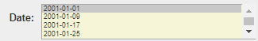
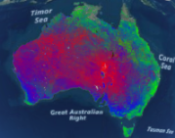
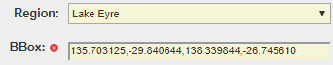
Technical Details - JavaScript
JS File: /NASA/WorldWind/nww_kml_ajax.js
Several functions are called in response to user selection and input on the HTML page.
<select name="layer" onchange="InsertTimes(this)">
Fetch and insert the data acquisition times.
times[i] = "2001-01-01T00:00:00.000Z,…,"
<select name="time" multiple="multiple">
Change the thumbnail image to suit the layer.
var main_images = ['geoglam_fractional_cover.png’,… ];
main_image.src = '/images/' + main_images[i];
<select name=“region" onchange="GetCoordinates(this.form,this)">
Fetch and insert the bounding box coordinates.
region["AU"] = "112.324219,-44.087585,153.984375,-10.919618";
<img onmousedown="ShowHideBBoxFinder(document.BBox_finder)">
var rand = Math.floor((Math.random()*1000000)+1);
var iframe = document.getElementById('BBox_finder');
iframe.src* = "/BBox?uid="+rand;
showHideToggle('bbox_finder', 'div');
bbox_finder=document.getElementById('bbox_finder');
bbox_finder.scrollIntoView(true);
<img onmousedown="GetBBoxValue(1)">
var bbox= document.getElementById('BBox_finder'*).contentWindow.document.getElementById('boxbounds').innerHTML;
form.bbox.value = bbox;
* BBox is an external program forked form here and modified to suit. It resides on the local server. See slide, ‘User Guide – BBox Finder’ for a view and description.

Slide 12
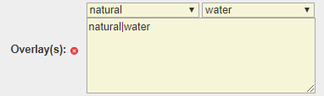
Technical Details – JavaScript (contd…)
JS File: /NASA/WorldWind/nww_kml_ajax.js
<img onmousedown="ZoomInAroundCrosshair();">
var crosshair= document.getElementById('BBox_finder').contentWindow.document.getElementById('center').innerHTML;
document.forms.google_earth.crosshair.value = crosshair;
var form = document.forms.google_earth;
var x1 = parseFloat(x) - parseFloat((zoom_size/10)); x1 = x1.toFixed(1);
var y1 = parseFloat(y) - parseFloat((zoom_size/10)); y1 = y1.toFixed(1);
var x2 = parseFloat(x) + parseFloat((zoom_size/10)) + 0.1; x2 = x2.toFixed(1);
var y2 = parseFloat(y) + parseFloat((zoom_size/10)) + 0.1; y2 = y2.toFixed(1);
var bbox = x1 + "," + y1 + "," + x2 + "," + y2;
form.bbox.value = bbox;
<select name="key" onchange="FillTheValues(this) ">
key_values["natural"] = ["bay","beach"…];
var key = item.value;
var values = key_values[key];
var select_list = "<select name="value" onchange="GetKeyValuePairs(this.form,this)">
select_list += " <option value=\"" + values[j] + "\" >" + values[j] + "</option>\n";
document.getElementById("key_values").innerHTML = select_list;
or
or
<input onclick="ValidateInput(document.forms.google_earth,1);">
document.getElementById("kml").innerHTML =
"<img alt=\"Wait!\"> Fetching...<input type=\"button\" value=\"Cancel\" onclick=\"CancelJob(this.form)\">";
ajaxFunction(1,form);

Slide 13
Technical Details – JavaScript (contd…)
JS File: /NASA/WorldWind/nww_kml_ajax.js
function ajaxFunction(n,form,item)
if (n == 1)
{
var times = []; // Select multiple times
for ( var i = 0; i < form.time.selectedOptions.length; i++)
{
times[i] = form.time.selectedOptions[i].value;
}
var bbox = form.bbox.value.replace(/ /g, '');
bbox = bbox.split(",");
var key_value_pairs = form.key_value_pairs.value;
key_value_pairs = key_value_pairs.replace(/\n/g, ";");
pquery =
"&layer=" + form.layer.value + "&region=" + form.region.value +
"&west=" + bbox[0] + "&south=" + bbox[1] + "&east=" + bbox[2] +
"&north=" + bbox[3] + "&time=" + times +
"&key_value_pairs=" + key_value_pairs;
pquery = escape(pquery);
pquery = pquery.replace("+","%2B");
var ran_number= Math.random()*5000;
url = cgi + "?GEOGLAM+" + ran_number + "+" + pquery;
}
xmlHttp.open("GET",url,true);
xmlHttp.send(null);
response = xmlHttp.responseText;
if (n == 1)
{
if(response)
{
var rand = Math.floor((Math.random()*1000000)+1);
var iframe = document.getElementById('NWW');
iframe.src = "http://130.56.242.19/NASA/WorldWind/nww_kml.html?"+rand;
showHide("kml", "div", "block");
}
else
{
document.getElementById("killed").innerHTML = "Timeout";
showHide("killed", "block");
}
}
Call the NASA World Wind engine
Call the CGI. See next slide.

Slide 14
Technical Details – CGI Outline
Program File: /cgi-bin/nww_kml.cgi
Note: Those who can read and understand Perl can skip this section (slides 11-20).
Outline of operation:
This Common Gateway Interface (CGI) is written in Perl due to the robustness of this programming language as a webserver backend. Any other language (PHP, Python, C/C++) can be used but GOlang is probably unsuitable. All calls to the CGI are through AJAX (Asynchronous JavaScript And XML) and no direct GET or POST method is used. Apart from the elegance and seamless operation of AJAX, it is more secure as well.
Clicking the following buttons will call the CGI through AJAX.
Display → JS:ValidateInput → CGI:action=GEOGLAM
Cancel → JS:CancelJob → CGI:action=Kill
BBox Paste → JS:GetBBoxValue → CGI:action=GEOGLAM
BBox Crosshair → JS:ZoomInAroundCrosshair → CGI:action=GEOGLAM
CGI:action=GEOGLAM
This is the main function and is described below. As the Flow Diagram on the right shows, there is a series of sequential events to create the KML file that displays the GSKY and Overlay layers via the NASA World Wind engine.
GEOGLAM: Calls ‘CreateSingleKML’ or ‘CreateMultipleKML’, depending on whether it is a single or multiple data acquisition date(s), followed by ‘GetTheOverlays’.
CreateSingleKML: Generates a single block of KML code that calls the WMS service from GSKY server. This code will insert a ‘GroundOverlay’ item in the KML, where the GSKY-returned PNG file is overlaid over a specified bounding box above the terrain. Unlike in a native WMS service, like in TerriaMap, QGIS or ArcGIS, where the software sends a different call to the GSKY server every time the map is panned or zoomed, the GroundOverlay simply moves so that it is always above the same BBox. No more calls wil go to the GSKY server and the server load will remain low.
CreateMultipleKML: Same as above, but iterates through multiple dates.
GetTheOverlays: This does several steps:
Create an ‘osm-script’ and send it to the Overpass API to get the layer data.
Convert the returned OSM data into GeoJSON and then to KML formats.
Extract only the required data from KML to create the final KML file to be used with NASA World Wind.
Save the KML file on disk, which is then read by the NASA World Wind engine to display the GSKY and Overlay layers.
Code Flow Diagram
Start
GEOGLAM
GSKY Layers
Overpass
Overlays
OSM
GeoJSON
Display
Placemark
KML

Slide 15
Technical Details - CGI
CGI File: /cgi-bin/nww_kml.cgi
Called as ‘method=GET’ from Ajax functions. There is no direct call to the CGI and no ‘method=POST’ action.
if ($sc_action eq "GEOGLAM")
{
print "Content-type: text/html\n\n";
$pquery = reformat($ARGV[2]);
Get_fields;
@fields = split (/\|/, $layer);
$layer = $fields[0]; $title = $fields[1]; $basetitle = $title;
if ($time =~ /,/)
{
# This is a multiple time selection
CreateMultipleKML;
GetTheOverlays;
print "<small>Fetched multiple dates! See the map above.</small>";
exit;
}
else
{
if ($time)
{
$date = $time;
$date =~ s/T.*Z//gi;
$time="TIME=$time";
}
$title = $basetitle . " " . $date;
CreateSingleKML;
GetTheOverlays;
print "<small>Fetched! See the map above.</small>";
}
exit;
}
Start
The ‘Get_fields’ retrieves the form input parameters from the web page. The ‘sub CreateMutipleKML’ is called if there are multiple values in the $time parameter. Otherwise, the ‘sub CreateSingle KML’ is called.
The ‘sub GetTheOverlays’ retrieves the data for the selected overlays by calling the ‘Overpass’ API, reformats the data and creates the final KML file.
Next: subs CreateMultipleKML and CreateSingleKML

Slide 16
Technical Details – CGI (contd…)
CGI File: /cgi-bin/nww_kml.cgi
sub CreateMultipleKML
{
$visibility = 1;
my @times = split(/,/, $time);
my $len = $#times;
for (my $j=0; $j <= $len; $j++)
{
$date = $times[$j]; $date =~ s/T.*Z//gi;
$title = $region . "_" . $basetitle . " " . $date;
$time = "";
if($times[$j]) { $time="TIME=$times[$j]"; }
GroundOverlay;
$visibility = 0; # Subsequent layers are set as visibility=0
}
$kml = $groundOverlay;
}
sub CreateSingleKML
{
my $x = ($east+$west)/2.0;
my $y = ($north+$south)/2.0;
my $eye = abs($south - $north)*150*1000;
$lookAt = "
<LookAt>
<longitude>$x</longitude>
<latitude>$y</latitude>
<altitude>$eye</altitude>
</LookAt>
";
$kml = "<GroundOverlay>
<name>$title</name>
<visibility>1</visibility>
<Icon>
<href>
http://130.56.242.15/ows/ge?SERVICE=WMS&amp;VERSION=1.1.1&amp;REQUEST=GetMap&amp;SRS=EPSG:4326&amp;WIDTH=512&amp;HEIGHT=512&amp;LAYERS=$layer&amp;STYLES=default&amp;TRANSPARENT=TRUE&amp;FORMAT=image/png&amp;BBOX=$west,$south,$east,$north&amp;$time
</href>
<viewRefreshMode>onStop</viewRefreshMode>
<viewBoundScale>0.75</viewBoundScale>
</Icon>
$lookAt
<LatLonBox>
<north>$north</north>
<south>$south</south>
<east>$east</east>
<west>$west</west>
</LatLonBox>
</GroundOverlay>
";
}
GEOGLAM
GEOGLAM
The ‘sub GroundOverlay’ creates a block of code for each date in the list. Such code will be identical to that created by ‘sub CreateSingleKML’ except for the ‘TIME=’ parameter in the call to GSKY server.
Next: sub GroundOverlay

Slide 17
Technical Details – CGI (Contd…)
CGI File: /cgi-bin/nww_kml.cgi
sub GroundOverlay
{
my $x = ($east+$west)/2.0;
my $y = ($north+$south)/2.0;
my $eye = abs($south - $north)*150*1000;
$lookAt = "
<LookAt>
<longitude>$x</longitude> <latitude>$y</latitude> <altitude>$eye</altitude>
</LookAt>
";
$groundOverlay .= "
<!-- $date -->
<GroundOverlay>
<name>$title</name>
<visibility>$visibility</visibility>
<Icon>
<href>
http://130.56.242.15/ows/ge?SERVICE=WMS&amp;BBOX=135.703125,-29.840644,138.339844,-26.745610&amp;TIME=2001-01-01T00:00:00.000Z&amp;VERSION=1.1.1&amp;REQUEST=GetMap&amp;SRS=EPSG:4326&amp;WIDTH=512&amp;HEIGHT=512&amp;LAYERS=global:c6:frac_cover&amp;STYLES=default&amp;TRANSPARENT=TRUE&amp;FORMAT=image/png
</href>
<viewRefreshMode>onStop</viewRefreshMode>
<viewBoundScale>0.75</viewBoundScale>
</Icon>
$lookAt
<LatLonBox>
<west>$west</west>
<south>$south</south>
<east>$east</east>
<north>$north</north>
</LatLonBox>
</GroundOverlay>
";
}
sub GetTheOverlays
{
my @key_value_pairs = split(/;/, $key_value_pairs);
my $len = $#key_value_pairs;
for ($j=0; $j <= $len; $j++)
{
$outline = $outlines[$j];
GetAndCreatePlacemarks($key_value_pairs[$j]);
}
my $xml = "<?xml version=\"1.0\" encoding=\"UTF-8\"?>
<kml xmlns=\"http://www.opengis.net/kml/2.2\">
<Document>
<name>_______Layers_______</name>
$kml
$overlay
<Folder>
<name>_____Placemarks_____</name>
</Folder>
</Document>
</kml>
";
$datadir = "/var/www/html/NASA/WorldWind/data/nww";
open(OUT, ">$datadir/nww.kml");
print OUT "$xml\n";
close(OUT);
}
GSKY Layers
Arbitrary calculation for camera elevation
Comment line to demarcate the time slices
WMS call to the GSKY server
Next: sub GetTheOverlays
The ‘sub ‘GetAndCreatePlacemarks’ creates an ‘osm-script’ to fetch the data from Overpass. The data is then re-formatted into GeoJSON and then into KML.
Next: sub GetAndCreatePlacemarks

Slide 18
Technical Details – CGI (Contd…)
CGI File: /cgi-bin/nww_kml.cgi
sub GetAndCreatePlacemarks
{
my $kv = $_[0]; my $overlay_name = $kv; my @kv = split(/\|/, $kv); my $key = $kv[0];
my $value = $kv[1]; my $osm_script = “”; my $txtfile = "$tmpdir/Tmp.txt";
my $osmfile = "$tmpdir/Tmp.osm"; my $geojsonfile = "$tmpdir/Tmp.geojson";
my $kmlfile = "$tmpdir/Tmp.kml";
open (OUT, ">$txtfile"); print OUT $osm_script; close(OUT);
`wget --post-file=$txtfile http://overpass-api.de/api/interpreter --output-document=$osmfile`;
`osmtogeojson $osmfile > $geojsonfile`;
`tokml $geojsonfile > $kmlfile`;
$nplacemark = 0;
$placemark = GetPlacemark($kmlfile);
if ($placemark)
{
$overlay .= "
<Folder>
<name>$overlay_name: $nplacemark</name>
<visibility>1</visibility>
$lookAt
$placemark
</Folder>
";
}
else
{
$overlay .= "
<Folder>
<name>$overlay_name: $nplacemark</name>
<visibility>0</visibility>
</Folder>
";
}
}
my $osm_script = "
<osm-script output=\"xml\" timeout=\"300\">
<union>
<query type=\"node\">
<has-kv k=\"$key\" v=\"$value\"/>
<bbox-query e=\"$east\" n=\"$north\" s=\"$south\" w=\"$west\"/>
</query>
<query type=\"way\">
<has-kv k=\"$key\" v=\"$value\"/>
<bbox-query e=\"$east\" n=\"$north\" s=\"$south\" w=\"$west\"/>
</query>
<query type=\"relation\">
<has-kv k=\"$key\" v=\"$value\"/>
<bbox-query e=\"$east\" n=\"$north\" s=\"$south\" w=\"$west\"/>
</query>
</union>
<union>
<item/>
<recurse type=\"down\"/>
</union>
<print mode=\"body\"/>
</osm-script>
";
`wget --post-file=$txtfile http://overpass-api.de/api/interpreter --output-document=$osmfile`;
The osm-script, in $txtfile, is sent to the overpass API via ‘wget’, which returns the data in OSM format and is saved as $osmfile (/NASA/WorldWind/data/Tmp/Tmp.osm)
Next: file Tmp.osm

Slide 19
Technical Details – CGI (Contd…)
`wget --post-file=$txtfile http://overpass-api.de/api/interpreter --output-document=$osmfile`;
The osm-script, in $txtfile, is sent to the overpass API via ‘wget’, which returns the data in OSM format and is saved as $osmfile (/NASA/WorldWind/data/Tmp/Tmp.osm)
Tmp.osm:
<?xml version="1.0" encoding="UTF-8"?>
<osm version="0.6" generator="Overpass API 0.7.55.7 8b86ff77">
<node id="303723661" lat="-29.1196035" lon="137.6718180"/>
<node id="303723662" lat="-29.1184038" lon="137.6752512"/>
…
<node id="6237806841" lat="-28.8947582" lon="136.5101298"/>
<way id="27653773">
<nd ref="303723661"/>
…
<nd ref="303723661"/>
<tag k="alt_name" v="Lake Eyre (South)"/>
<tag k="intermittent" v="yes"/>
<tag k="name" v="Kati Thanda-Lake Eyre (South)"/>
<tag k="natural" v="water"/>
<tag k="salt" v="yes"/>
<tag k="source" v="yahoo"/>
<tag k="water" v="lake"/>
</way>
<tag k="alt_name" v="Lake Eyre (South)"/>
</way>
<relation id="253952">
<member type="way" ref="27729223" role="outer"/>
…
<member type="way" ref="35938226" role="inner"/>
<tag k="alt_name" v="Lake Eyre (North)"/>
</relation>
</osm>
Nodes are the points to form the polygons
Way ID lists the Nodes which in turn give the Lat/Lon to form a closed polygon
Relations define how the polygons are related. The “inner” polygons are enclosed in “outer”.
The OSM data will be converted to GeoJSON using ‘osmtogeojson’
Next: file Tmp.geojson

Slide 20
Technical Details – CGI (Contd…)
`osmtogeojson $osmfile > $geojsonfile`;
The osm data in $osmfile is converted into GeoJSON format and saved in $geojsonfile (/NASA/WorldWind/data/Tmp/Tmp.geojson)
Tmp.geojson:
{
"type": "FeatureCollection",
"features": [
{
"type": "Feature",
"id": "relation/253952",
"properties": {
"alt_name": "Lake Eyre (North)",
"natural": "water",
},
"geometry": {
"type": "MultiPolygon",
"coordinates": [[[[137.7264071,-28.1236032],[137.7276088,-28.1267824]]]]
}
},
{
"type": "Feature",
"id": "node/371088118",
"properties": {
"name": "Muloorina Bore",
"natural": "water",
},
"geometry": {
"type": "Point",
"coordinates": [137.8996898,-29.2383169]
}
}
]
}
osmtogeojson is a Javascript module for converting OSM data (OSM XML or Overpass JSON) to GeoJSON. It can be used as a command line tool. This OSM conversion code was written for and is maintained by the overpass-turbo project. [Ref]
Install:
$ npm install -g osmtogeojson
$ osmtogeojson file.osm > file.geojson
A feature could be a [multi]polygon, line or point.
Lat/Lon coordinates
The GeoJSON data will be converted to KML using ‘tokml’
Next: file Tmp.kml

Slide 21
Technical Details – CGI (Contd…)
`tokml $geojsonfile > $kmlfile`;
The GeoJSON data in $geojsonfile is converted into KML format and saved in $kmlfile (/NASA/WorldWind/data/Tmp/Tmp.kml)
Tmp.kml:
<?xml version="1.0" encoding="UTF-8"?><kml xmlns="http://www.opengis.net/kml/2.2">
<Document>
<Placemark>
<ExtendedData>
<Data name="name">
<value>Kati Thanda-Lake Eyre (North)</value>
</Data>
...
<Data name="id">
<value>relation/253952</value>
</Data>
</ExtendedData>
<MultiGeometry>
<Polygon>
<outerBoundaryIs>
<LinearRing>
<coordinates>137.7264071,-28.1236032 137.7276088,-28.1267824</coordinates>
</LinearRing>
</outerBoundaryIs>
</Polygon>
...
<Polygon>
...
</Polygon>
</MultiGeometry>
</Placemark>
</Document>
</kml>
tokml is a Javascript module for converting GeoJSON data KML. It is used as a command line tool. This GeoJSON conversion code was written for and is maintained by the Mapbox project.
Install:
$ npm install --save tokml
$ tokml file.geojson > file.kml
Only the polygons are required by GskyNWW
Lat/Lon coordinates
The $kmlfile is passed to ‘sub GetPlaceMark’ for creating the KML file used by NWW.
Next: sub GetPlaceMark

Slide 22
Technical Details – CGI (Contd…)
$placemark = GetPlacemark($kmlfile);
if ($placemark)
{
$overlay .= "
<Folder>
<name>$overlay_name: $nplacemark</name>
<visibility>1</visibility>
$lookAt
$placemark
</Folder>
";
}
sub GetPlacemark
{
my $filename = $_[0];
open (INP, "<$filename"); my @filecontent = <INP>; close(INP);
@filecontent = split(/<Placemark>/, $filecontent[0]); my $len = $#filecontent;
my $placemark = "";
for (my $j=1; $j < $len; $j++)
{
my $polygon = "";
if ($filecontent[$j] =~ /<Polygon>(.*)<\/Polygon>/i)
{
$polygon = $1;
}
my $tempfile = "$tmpdir/placemark.tmp";
open(OUT, ">$tempfile"); print OUT "<Placemark>$filecontent[$j]\n"; close(OUT);
my $xml_doc = $parser->parsefile ($tempfile);
$xml_hash = $xml_converter->fromDOMtoHash($xml_doc);
my $name = $blank_name;
if ($shownames && $xml_hash->{Placemark}->{ExtendedData}->{Data}[0]->{name} eq "name")
{
$name = $xml_hash->{Placemark}->{ExtendedData}->{Data}[0]->{value}->{text};
}
if ($polygon)
{
$nplacemark++;
$placemark .= "<Placemark>\n" .
"\t\t\t<name>$name</name>\n" .
"\t\t\t<visibility>1</visibility>\n" .
"\t\t\t<Style><LineStyle><color>$outline</color></LineStyle>
<PolyStyle><fill>1</fill></PolyStyle></Style>\n" .
"\t\t\t<MultiGeometry><Polygon>$polygon</Polygon></MultiGeometry>\n" .
"\t\t</Placemark>\n\t\t";
}
}
return $placemark;
}
This sub extracts the required data from Tmp.kml to create placemarks from polygons.
The $kmlfile (Tmp.kml)
XYZ coordinates.
Polygons
Write out to parse as a Hash
$lookAt
<LookAt>
<longitude>137.55</longitude>
<latitude>-30.25</latitude>
<altitude>315000</altitude>
</LookAt>
use XML::Hash; use XML::DOM;
$placemark
<Placemark>
<name>Wirragilpina Swamp</name>
<visibility>1</visibility>
<Style><LineStyle><color>ff00ff00</color></LineStyle>
<PolyStyle><fill>1</fill></PolyStyle></Style>
<MultiGeometry><Polygon><outerBoundaryIs>
<LinearRing>
<coordinates>136.6221,-29.869329 …</coordinates>
</LinearRing>
</outerBoundaryIs></Polygon></MultiGeometry>
</Placemark>
Multiple polygons are added.
Next: file nww.kml

Slide 23
Technical Details – CGI (Contd…)
sub GetTheOverlays
{
my @key_value_pairs = split(/;/, $key_value_pairs);
my $len = $#key_value_pairs;
for ($j=0; $j <= $len; $j++)
{
$outline = $outlines[$j];
GetAndCreatePlacemarks($key_value_pairs[$j]);
}
my $xml = "<?xml version=\"1.0\" encoding=\"UTF-8\"?>
<kml xmlns=\"http://www.opengis.net/kml/2.2\">
<Document>
<name>_______Layers_______</name>
$kml
$overlay
<Folder>
<name>_____Placemarks_____</name>
</Folder>
</Document>
</kml>
";
$datadir = "/var/www/html/NASA/WorldWind/data/nww";
open(OUT, ">$datadir/nww.kml");
print OUT "$xml\n";
close(OUT);
}
This file is user-specific, and named as ‘nww_123456789.kml’. See next slide for details.
nww_kml
<?xml version="1.0" encoding="UTF-8"?> <kml xmlns="http://www.opengis.net/kml/2.2">
<Document> <name>_______Layers_______</name>
<GroundOverlay>
<name>Fractional Cover C6 2001-01-01</name> <visibility>1</visibility>
<Icon>
<href>
http://130.56.242.15/ows/ge?SERVICE=WMS&...TIME=2001-01-01T00:00:00.000Z
</href>
<viewRefreshMode>onStop</viewRefreshMode>
<viewBoundScale>0.75</viewBoundScale>
</Icon>
<LookAt>
<longitude>137.55</longitude> <latitude>-30.25</latitude> <altitude>315000</altitude>
</LookAt>
<LatLonBox>
<north>-29.2</north> <south>-31.3</south> <east>138.6</east> <west>136.5</west>
</LatLonBox>
</GroundOverlay>
<!-- Visible Overlays -->
<Folder>
<name>natural|wetland: 10</name> <visibility>1</visibility>
<LookAt>
<longitude>137.55</longitude> <latitude>-30.25</latitude> <altitude>315000</altitude>
</LookAt>
<Placemark>
<name>Fred Swamp</name>
<visibility>1</visibility>
<Style><LineStyle><color>ff00ff00</color></LineStyle><PolyStyle><fill>1</fill></PolyStyle></Style>
<MultiGeometry><Polygon><outerBoundaryIs><LinearRing><coordinates>136.780412,-31.165489 </coordinates></LinearRing></outerBoundaryIs></Polygon></MultiGeometry>
</Placemark>
<!-- Unavailable Overlays -->
<Folder>
<name>natural|volcano: 0</name>
<visibility>0</visibility>
</Folder>
<!-- End of Overlays -->
<Folder> <name>_____Placemarks_____</name> </Folder>
</Document>
</kml>
Content of ‘nww.kml’
File written as ‘nww.kml’
nww_kml.js: var kmlFilePromise = new WorldWind.KmlFile(nww_kml,
[new WorldWind.KmlTreeVisibility('treeControls', wwd)]);
nww_kml.html: <script data-main=“nww_kml" src="https://cdnjs.cloudflare.com/ajax/libs/require.js/2.1.17/require.min.js"></script>
geoglam_wrapper_kml.html: <div id="nww_section" style="display:none">
<iframe id="NWW" src=nww_kml.html"></iframe></div>

Slide 24
Technical Details – CGI (Contd…)
nww_kml_ajax.js:
Except the KML file (‘nww_kml’) for displaying in the World Wind pane, all other JS, HTML and KML files are static. The ‘nww_kml’ is generated by the CGI, stored in ‘data/nww’ directory and read by ‘nww_kml.js’.
To prevent the overwriting of this file when there are two or more simultaneous users, it must have a different name between the users. Though a simple logic would be to give it a random name each time, it will result in too many files being created and stored on the server, and will require periodic cleanup.
Instead, a user-specific string held in a permanent cookie is used to name this file. The same user running the program on the same device and browser will create only one file. The code to do it is given below.
The ‘nww_kml_ajax.js’ creates the cookie and ‘nww_kml.cgi’ reads it to write the KML. The ‘nww_kml.js’ reads the cookie to find the KML and use it in displaying the World Wind view.
function ajaxFunction(n,form,item)
{
if (n == 1) // KML
{
CSReadCookie();
…
}
…
}
function CSReadCookie()
{
var cookies = document.cookie;
cookies = unescape(cookies);
if (!cookies)
{
createCookie();
}
}
function createCookie()
{
var days = 36500;
var cookiename = "GSKY-NWW-GEOGLAM";
var value = Math.floor((Math.random()*1000000000)+1);
if (days) {
var date = new Date();
date.setTime(date.getTime()+(days*24*60*60*1000));
var expires = "; expires="+date.toGMTString();
}
else var expires = "";
document.cookie = cookiename+"="+value+expires+"; path=/";
}
nww_kml.cgi:
if ($sc_action eq "GEOGLAM")
{
$nww_kml = "$datadir/nww.kml";
$value = GetGSKYcookie;
if ($value)
{
$nww_kml = "$datadir/nww_$value\.kml";
}
…
}
sub GetGSKYcookie
{
my $name = "GSKY-NWW-GEOGLAM";
@words = ();
$cookies = $ENV{'HTTP_COOKIE'};
if (!$cookies) { return; }
@cookiesArray = split (/;/, "$cookies");
foreach $cookieItem (@cookiesArray)
{
if ($cookieItem =~ /$name/)
{
@words = split (/=/, "$cookieItem");
}
}
$value = $words[1]; return $value;
}
Contd…

Slide 25
Technical Details – CGI (Contd…)
nww_kml.js:
function CSReadCookie()
{
var cookies = document.cookie;
cookies = unescape(cookies);
return cookies;
}
function ParseCookies(cookies,id)
{
var cookies_array = cookies.split(";");
nc = cookies_array.length;
for (var j=0; j < nc; j++)
{
var i = cookies_array[j].indexOf(id, 0);
if (i >= 0)
{
var i = cookies_array[j].indexOf('=', 0);
var cookie_value = cookies_array[j].substring(i+1,cookies_array[j].length);
return cookie_value;
}
}
return "";
}
var nww_kml = 'data/nww/nww.kml';
var cookiename = "GSKY-NWW-GEOGLAM";
var cookies = CSReadCookie(cookiename);
var cookie_value = ParseCookies(cookies,cookiename);
if (cookie_value)
{
nww_kml = "data/nww/nww_"+cookie_value+".kml";
}
…
var kmlFilePromise = new WorldWind.KmlFile(nww_kml, [new WorldWind.KmlTreeVisibility('treeControls', wwd)]);

Slide 26
Technical Details – CGI (Contd…)
Return value from the CGI to the AJAX function is used to determine whether the NASA World Wind engine must be called or not. If successful, the return message will be something like “Fetched”. If the CGI times out, as happens if the selected region is too big so that Overpass times out or takes too long, the return message will be NULL.
The AJAX function will call the NASA World Wind engine (see the code on right) based on the CGI response.
The GSKY and Overlay layers will be shown on the globe that opens up above the web form. It may take several seconds to display, depending on the complexity of the dynamic KML. A large KML may even freeze the World Wind engine and/or crash the browser.
response = xmlHttp.responseText;
if (n == 1)
{
if(response)
{
var rand = Math.floor((Math.random()*1000000)+1);
var iframe = document.getElementById('NWW');
iframe.src = "http://130.56.242.19/NASA/WorldWind/nww_kml.html?"+rand;
showHide("kml", "div", "block");
}
else
{
document.getElementById("killed").innerHTML = "Timeout";
showHide("killed", "block");
}
}
Call the NASA World Wind engine

Slide 27
Technical Details – Bbox Finder
The ‘Bbox Finder’ is a unique App that lets one draw a box around a region on the world map and get its bounding Lat/Lon coordinates. This is a third party software that has been integrated into GSKY-NWW as a local server program.
Some changes from the original code were required to incorporate it into GSKY-NWW. These changes are described below.
The system comprises of an ‘index.html’ and multiple JS files. Only one JS file, ‘js/bbox.js’, needs to be modified to suit our purposes. The complete source code is available in GitHUB, and the author encourages others to fork it. Hence, presumably, there is no licensing issue. Upon writing to the author, specifically inquiring about licensing, there was no reply.
The map tiles are fetched from an external server, ‘https://a.tiles.mapbox.com’, and requires an authorisation token.
L.mapbox.accessToken = 'pk.eyJ1IjoiY3Vnb3MiLCJhIjoiY2p4Nm43MzA3MDFmZDQwcGxsMjB4Z3hnNiJ9.SQbnMASwdqZe6G4n6OMvVw’;
Currently we are using a default token as given above, but must investigate how to get our own token.
Changes in index.html:
Commented out the link to the GitHUB repo.
<!-- <a href="https://github.com/aaronr/bboxfinder.com"><img … alt="Fork me on GitHub"></a>-->
Added some Help text.
<textarea readonly placeholder="Looking for a little help?" title="Help Me">…</textarea>
Masked the section displaying the coordinates. The user does not need to see it for the program to take the values.
<div id="info" style="display:none">
Changed ‘Hide’ to ‘Show’
<li id="info-toggle-button">Show Coordinates</li>
Changes in js/bbox.js: None
Contd…

Slide 28
Technical Details – Bbox Finder
The Bbox Finder is displayed in an iFrame on the main GSKY-NWW page. This enables the JavaScript to get the Bbox and crosshair coordinates to be inserted into the main form. For this, it is essential to have the source page in an iFrame residing on the same domain name. Cross-domain source file will not let the JavaScript to access its contents.
Bbox coordinates:
var bbox= document.getElementById('BBox_finder').contentWindow.document.getElementById('boxbounds').innerHTML;
Crosshair coordinates:
var crosshair= document.getElementById('BBox_finder').contentWindow.document.getElementById('center').innerHTML;
Next: Mobile Compatibility

Slide 29
Technical Details – Mobile Compatibility
The front page, as well as results, must be modified to be mobile friendly. To be less complicated at the code level, we are using separate pages and JS for the mobile. These changes are documented below. The CGI does not require any change.
Desktop: http://130.56.242.19/NASA/WorldWind/geoglam_wrapper_kml.html
Mobile: http://130.56.242.19/NASA/WorldWind/m_geoglam_wrapper_kml.html
Code to detect a mobile device (see below) is included in the <head></head> section of the desktop version. Virtually all mobiles since the stone age will be detected. This code should not be in the mobile version, or else it will go into a loop.
<script>
var url = document.location.href;
if(url.indexOf('index.html') >= 0) url = url.replace('index.html','m_geoglam_wrapper_kml.html');
else url = 'm_geoglam_wrapper_kml.html';
(function(a,b){if(/(android|bb\d+|meego).+mobile|avantgo|bada\/|blackberry|blazer|compal|elaine|fennec|hiptop|iemobile|ip(hone|od)|iris|kindle|lge |maemo|midp|mmp|mobile.+firefox|netfront|opera m(ob|in)i|palm( os)?|phone|p(ixi|re)\/|plucker|pocket|psp|series(4|6)0|symbian|treo|up\.(browser|link)|vodafone|wap|windows ce|xda|xiino/i.test(a)||/1207|6310|6590|3gso|4thp|50[1-6]i|770s|802s|a wa|abac|ac(er|oo|s\-)|ai(ko|rn)|al(av|ca|co)|amoi|an(ex|ny|yw)|aptu|ar(ch|go)|as(te|us)|attw|au(di|\-m|r |s )|avan|be(ck|ll|nq)|bi(lb|rd)|bl(ac|az)|br(e|v)w|bumb|bw\-(n|u)|c55\/|capi|ccwa|cdm\-|cell|chtm|cldc|cmd\-|co(mp|nd)|craw|da(it|ll|ng)|dbte|dc\-s|devi|dica|dmob|do(c|p)o|ds(12|\-d)|el(49|ai)|em(l2|ul)|er(ic|k0)|esl8|ez([4-7]0|os|wa|ze)|fetc|fly(\-|_)|g1 u|g560|gene|gf\-5|g\-mo|go(\.w|od)|gr(ad|un)|haie|hcit|hd\-(m|p|t)|hei\-|hi(pt|ta)|hp( i|ip)|hs\-c|ht(c(\-| |_|a|g|p|s|t)|tp)|hu(aw|tc)|i\-(20|go|ma)|i230|iac( |\-|\/)|ibro|idea|ig01|ikom|im1k|inno|ipaq|iris|ja(t|v)a|jbro|jemu|jigs|kddi|keji|kgt( |\/)|klon|kpt |kwc\-|kyo(c|k)|le(no|xi)|lg( g|\/(k|l|u)|50|54|\-[a-w])|libw|lynx|m1\-w|m3ga|m50\/|ma(te|ui|xo)|mc(01|21|ca)|m\-cr|me(rc|ri)|mi(o8|oa|ts)|mmef|mo(01|02|bi|de|do|t(\-| |o|v)|zz)|mt(50|p1|v )|mwbp|mywa|n10[0-2]|n20[2-3]|n30(0|2)|n50(0|2|5)|n7(0(0|1)|10)|ne((c|m)\-|on|tf|wf|wg|wt)|nok(6|i)|nzph|o2im|op(ti|wv)|oran|owg1|p800|pan(a|d|t)|pdxg|pg(13|\-([1-8]|c))|phil|pire|pl(ay|uc)|pn\-2|po(ck|rt|se)|prox|psio|pt\-g|qa\-a|qc(07|12|21|32|60|\-[2-7]|i\-)|qtek|r380|r600|raks|rim9|ro(ve|zo)|s55\/|sa(ge|ma|mm|ms|ny|va)|sc(01|h\-|oo|p\-)|sdk\/|se(c(\-|0|1)|47|mc|nd|ri)|sgh\-|shar|sie(\-|m)|sk\-0|sl(45|id)|sm(al|ar|b3|it|t5)|so(ft|ny)|sp(01|h\-|v\-|v )|sy(01|mb)|t2(18|50)|t6(00|10|18)|ta(gt|lk)|tcl\-|tdg\-|tel(i|m)|tim\-|t\-mo|to(pl|sh)|ts(70|m\-|m3|m5)|tx\-9|up(\.b|g1|si)|utst|v400|v750|veri|vi(rg|te)|vk(40|5[0-3]|\-v)|vm40|voda|vulc|vx(52|53|60|61|70|80|81|83|85|98)|w3c(\-| )|webc|whit|wi(g |nc|nw)|wmlb|wonu|x700|yas\-|your|zeto|zte\-/i.test(a.substr(0,4)))window.location=b})(navigator.userAgent||navigator.vendor||window.opera,url);
</script>

Slide 30
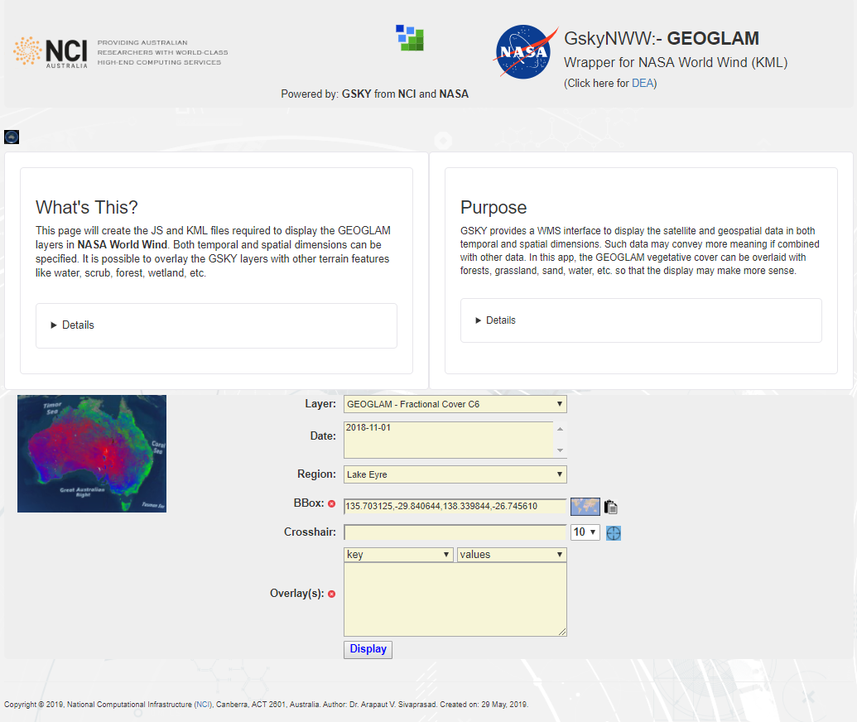
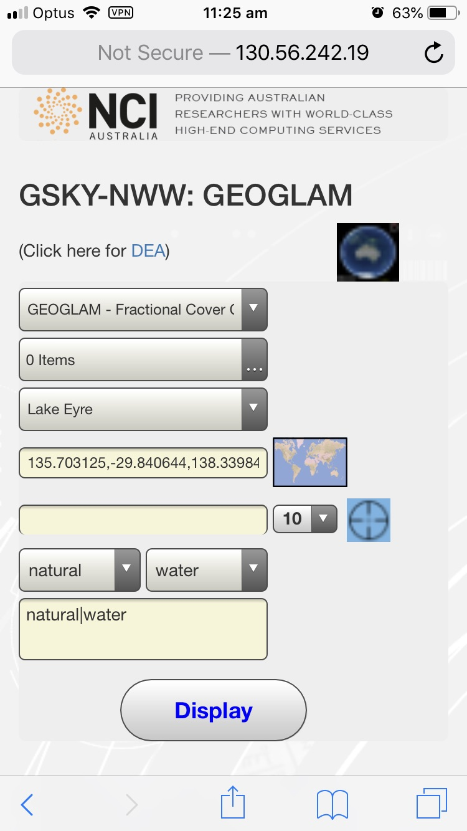
Technical Details – Mobile Compatibility
The main changes are to remove the descriptive text and to make the form elements bigger and less cluttered. The whole page is now fully displayed on the mobile screen as the picture below.
Desktop Page
Mobile (iPhone) Page
Top section and all descriptive text removed.
Larger button to toggle World Wind view pane
Larger dropdowns, input boxes and buttons
Paste button removed, as drawing a bounding box will not work on mobiles.
See the HTML source code for more details about the above changes. The only other change is the following to use a different JS file in the mobile version.
<script src="/NASA/WorldWind/m_nww_kml_ajax.js"></script>

Slide 31
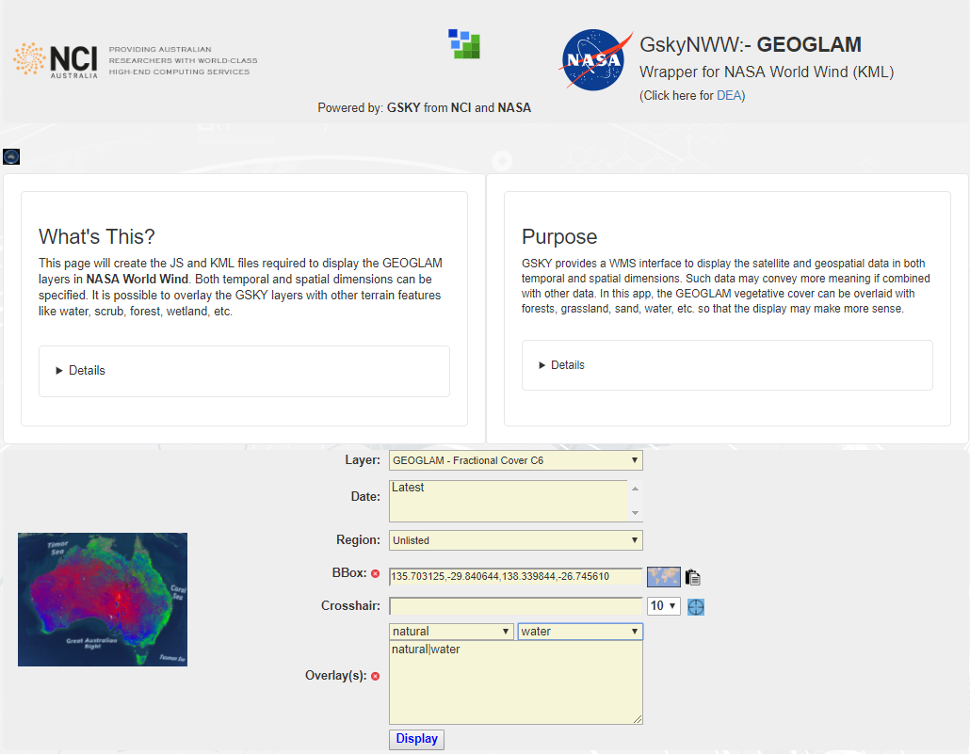
User Guide – Web Wrapper
This slide must be viewed as Slide Show
http://130.56.242.19/NASA/WorldWind/geoglam_wrapper_kml.html
Clicking this button will toggle the World Wind view pane where the globe is displayed.
A brief description about this web wrapper. Get more information by clicking ‘Details’ below.
The logic behind this web wrapper. The ‘Details’ below will show concise operation of the program.
Expanded description
How to operate
All available GEOGLAM layers are listed here, and one is selected by default. Selecting another will fill the ‘Date’ box with the data acquisition dates for that layer and change the thumbnail picture.
All available data acquisition dates for the selected GEOGLAM layer will be listed here. You can select more than one by Ctrl-click or Shift-click.
Several geographical regions are hard coded here for simplicity. Select one from the list or manually input the bounding box coordinates for any other region.
Thumbnail that will show how the selected layer will look over Australia. Clicking this image will toggle the World Wind view pane where the globe is displayed.
Locate a region by placing a crosshair on a map (see next slide). Click the crosshair icon to insert the BBox coordinates and fetch the data.
Select one or more overlay layers. Selecting the key (left) will list all its values (right) from which the selection(s) are made. Manually delete a line or delete all by clicking the cross button.
Click ‘Display’ to fetch the GEOGLAM layers plus the overlay layers, if any, and call the World Wind engine to display the globe. Depending on the area and the overlays it may take a few seconds to 2 minutes. Can cancel if taking too long. Will time out after 2 minutes.
Display a ‘Bbox Finder’ (see next slide) to define a region on a map. Clicking the paste button will insert the coordinates and fetch the data.

Slide 32
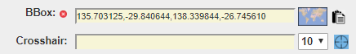
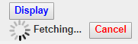
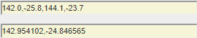
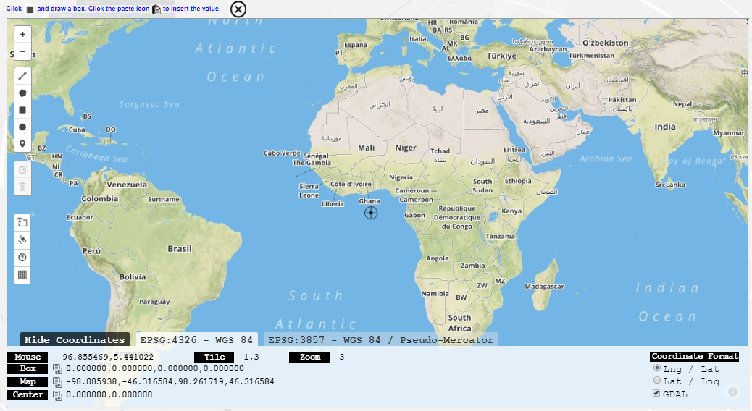
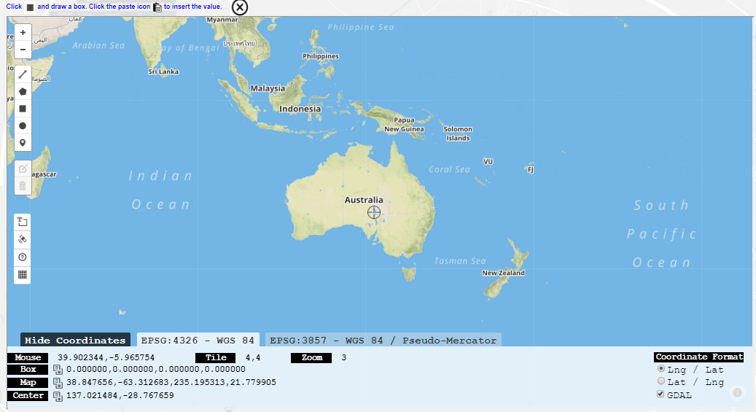
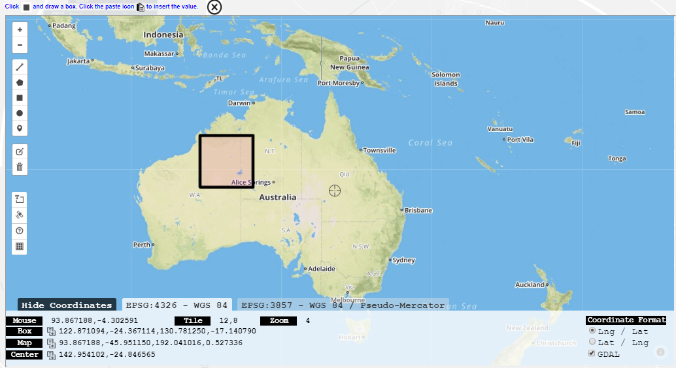
User Guide – BBox Finder
The BBox Finder is a separate program that is embedded into GskyNWW. It helps to get the minX, minY, maxX, maxY values of a box drawn on the map. This value will be fetched and inserted into the wrapper for creating the GSKY and/or overlay layers. The BBox Finder also lets you move a crosshair into position and display the GSKY layers around it.
Cancel if taking too long to fetch
A number from 1 to 25 in the dropdown defines the area around the crosshair. One unit is 1 tile of ~22 km². Therefore, 10 means 100 tiles (220km²) and 25 means 625 tiles (550 km²)
BBox Tool
BBox
Crosshair
Coordinates

Slide 33
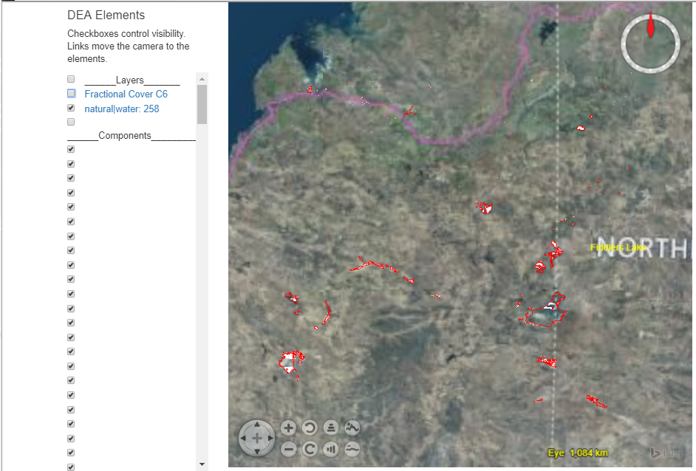
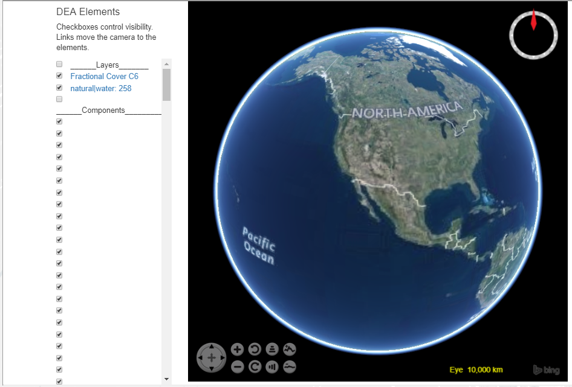
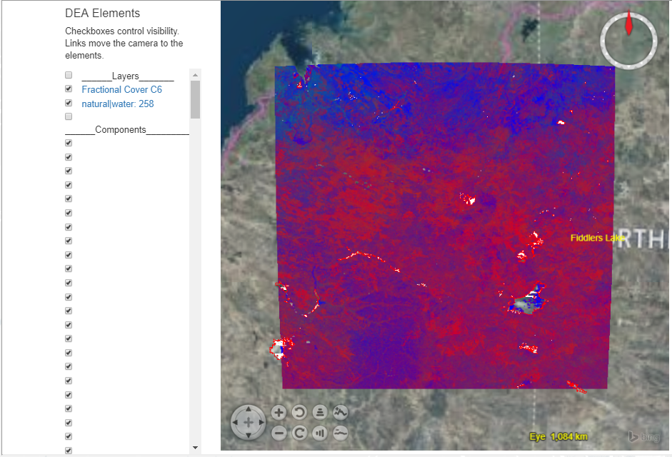
User Guide – World Wind Pane
The overlay layer(s) will be superimposed on the GSKY layer. Click the links to zoom to the area.
If multiple dates are selected, only the first in the list will be shown and the rest will not be visible initially. Check/uncheck the time layers to see how they differ.
Next: Usage on Mobiles
NOTE: You must be connected to the NCI through VPN. See the next slide for instructions to setup VPN on mobiles.

Slide 34
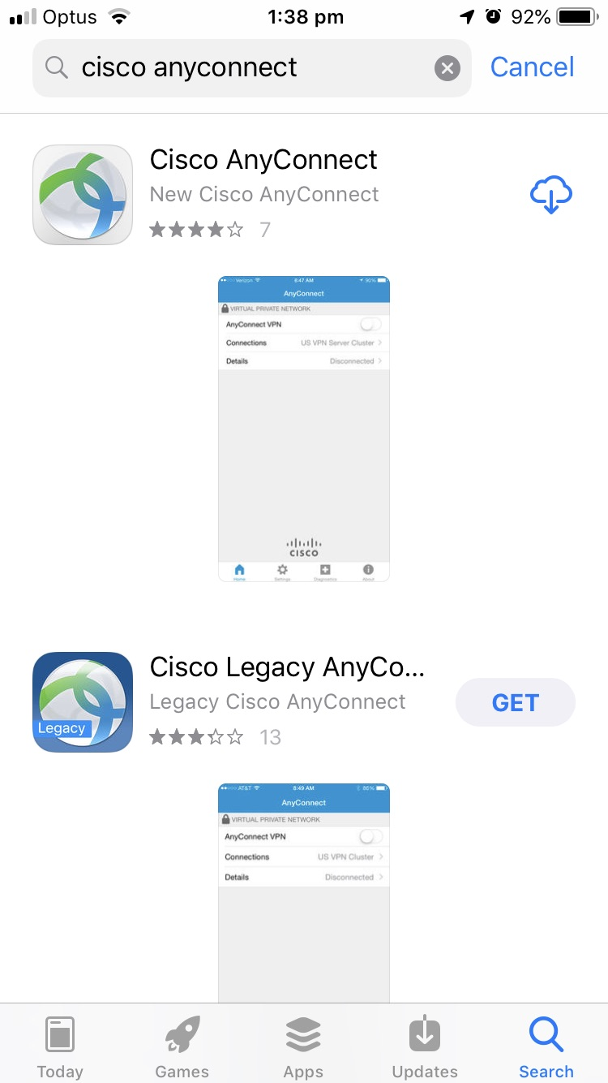
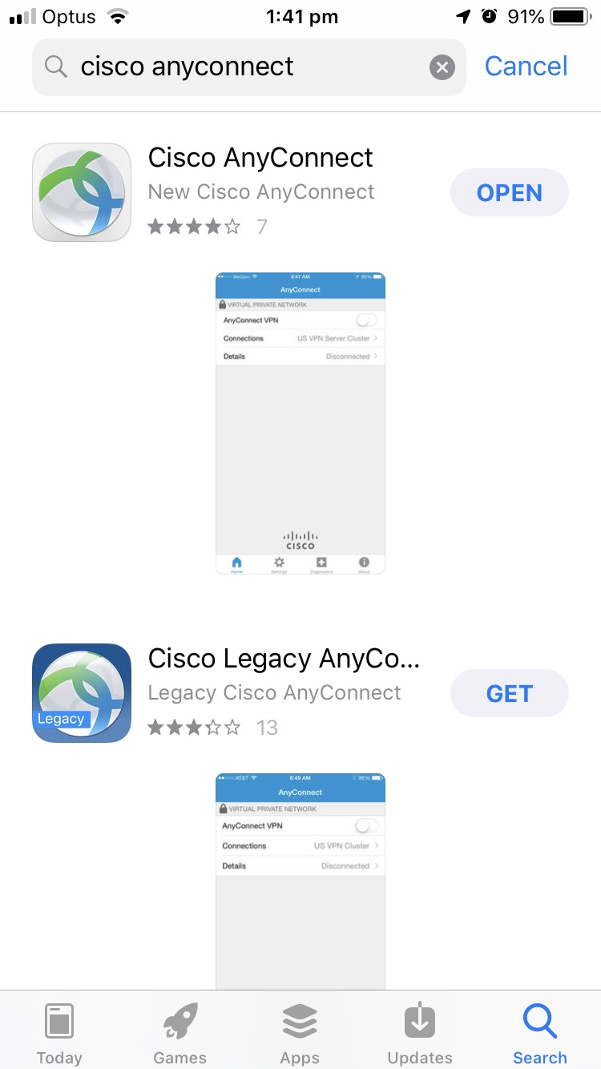
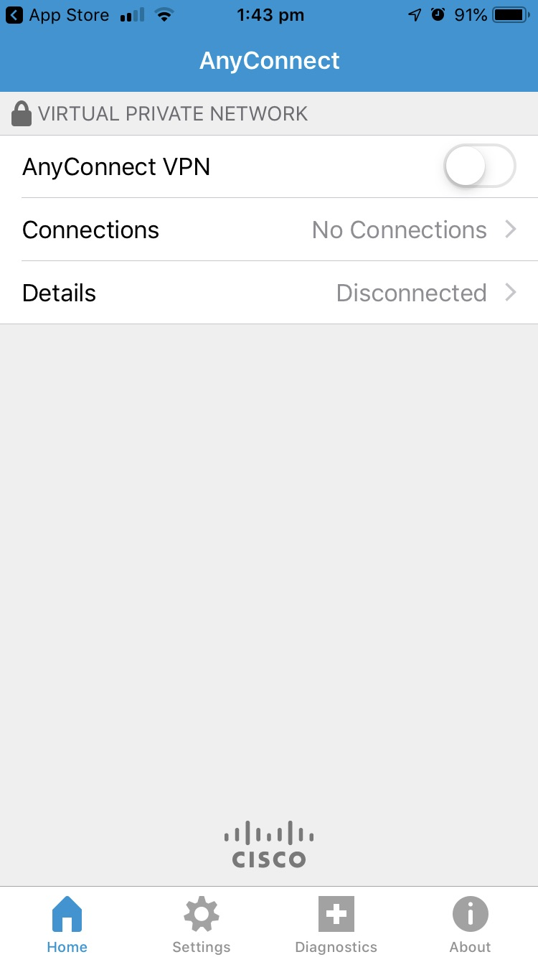
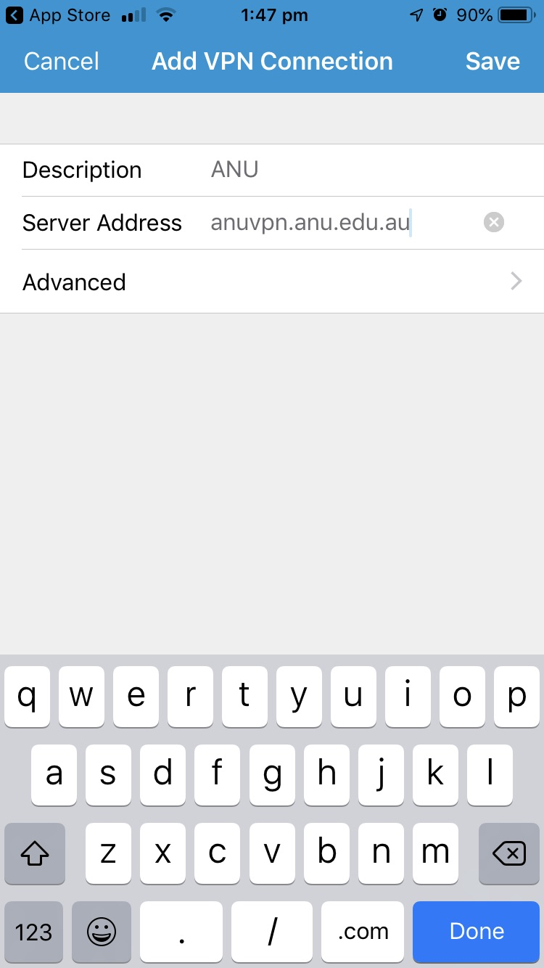
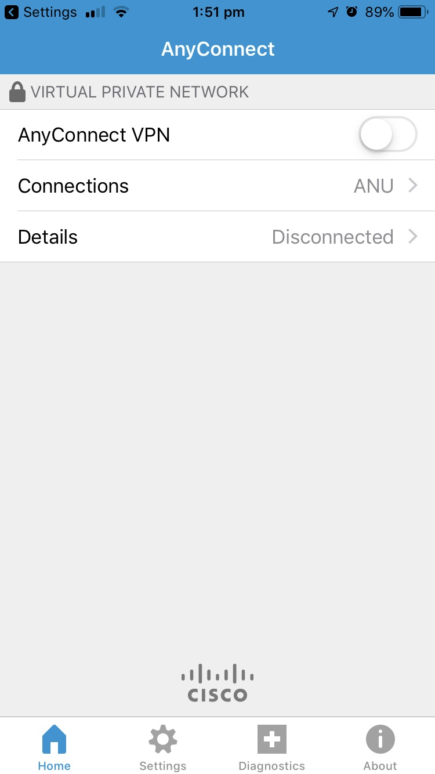
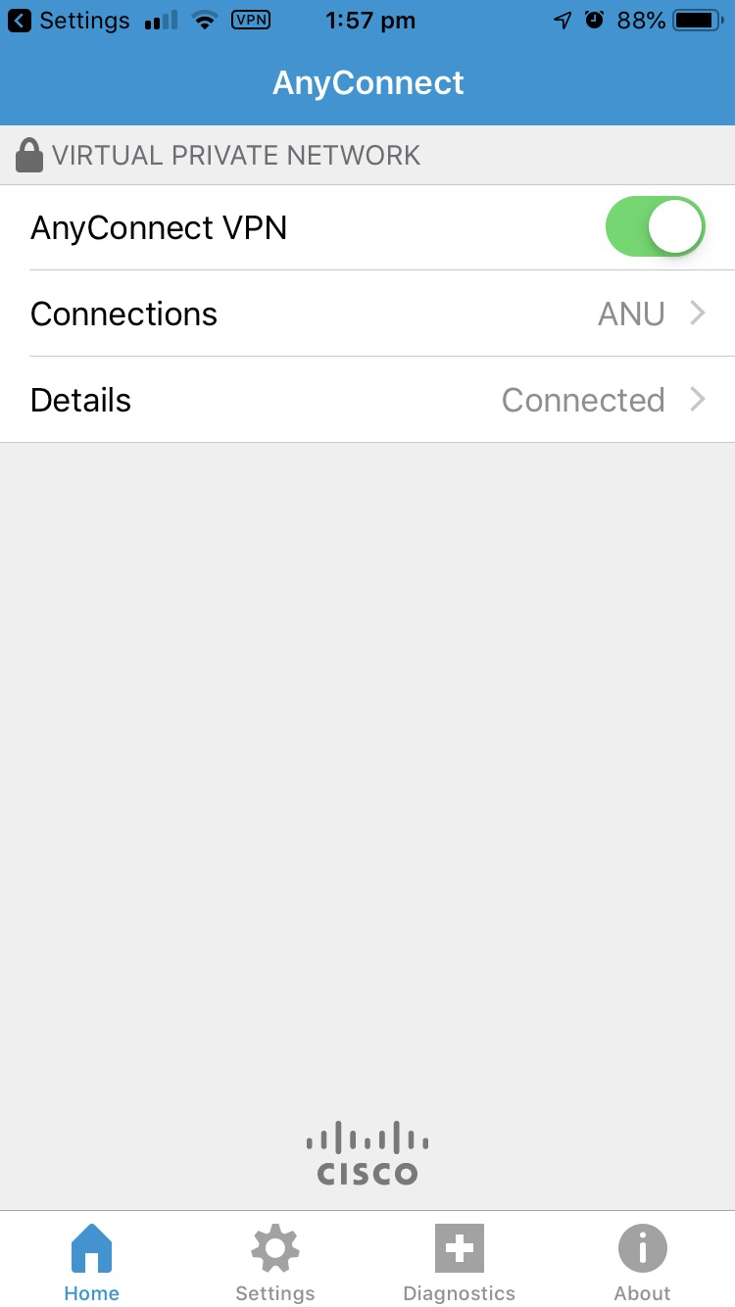
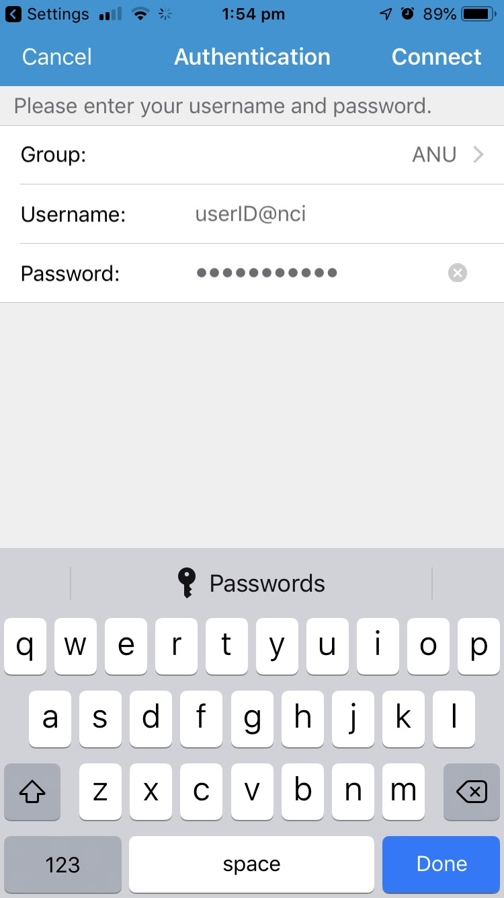
User Guide – Usage on Mobiles
This slide must be viewed as a slideshow
Setup VPN
This section describes the use of GSKY-NWW on mobiles. The VPN must be installed and connected to the NCI network.
Next: Mobile Version

Slide 35
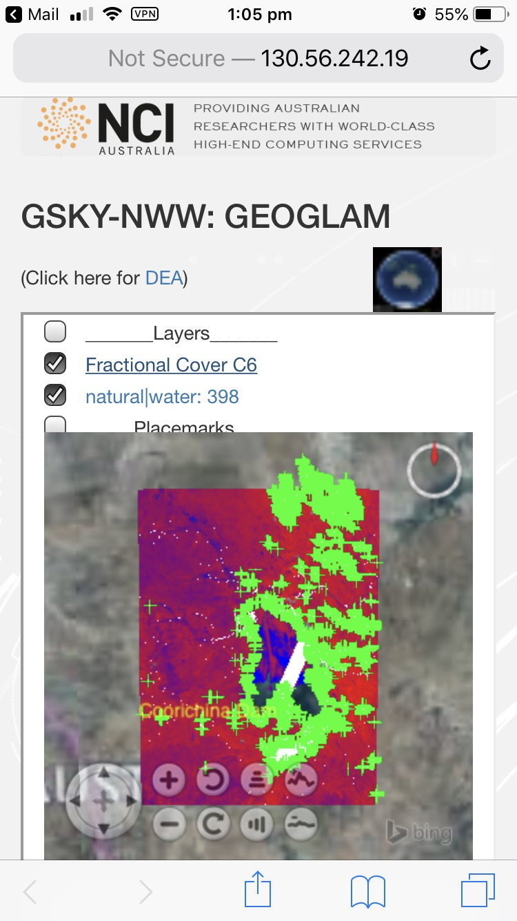
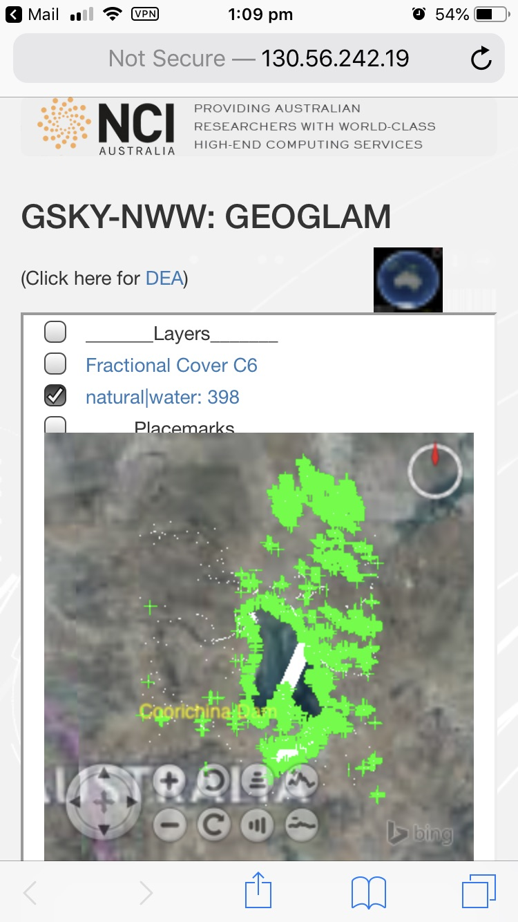
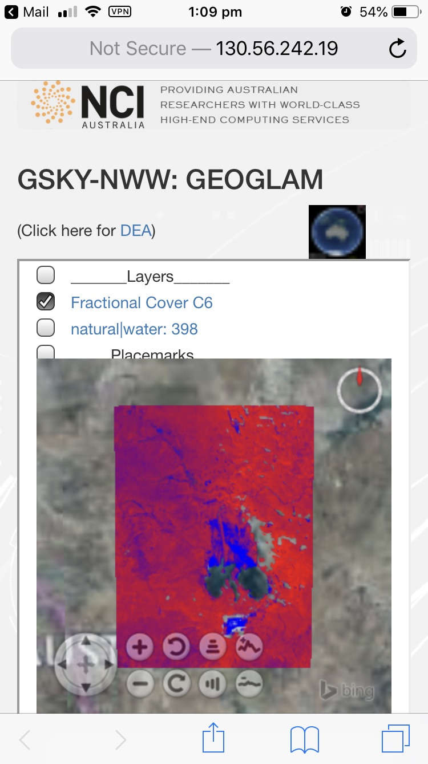

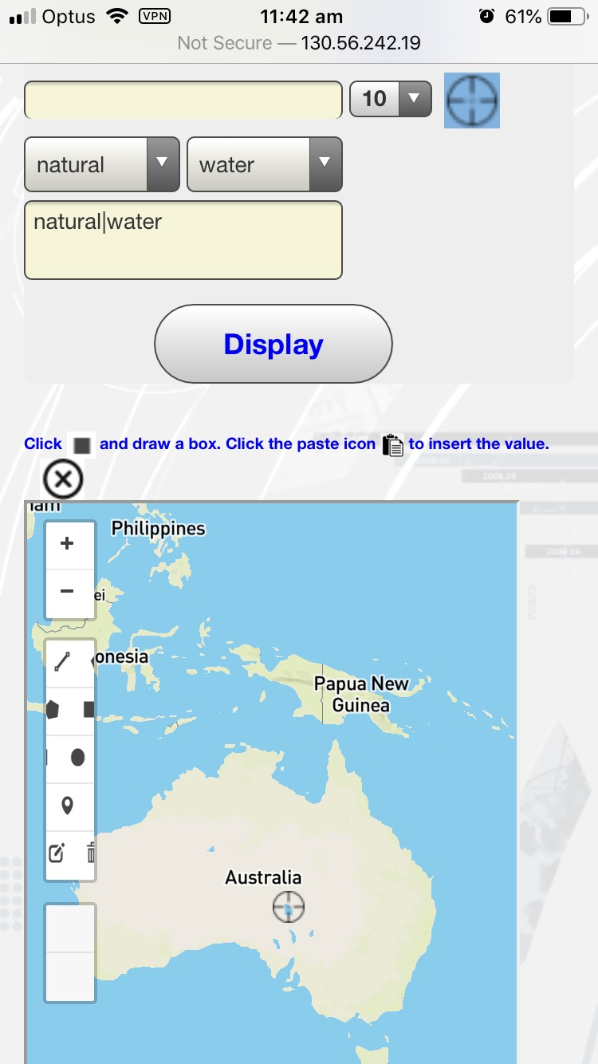
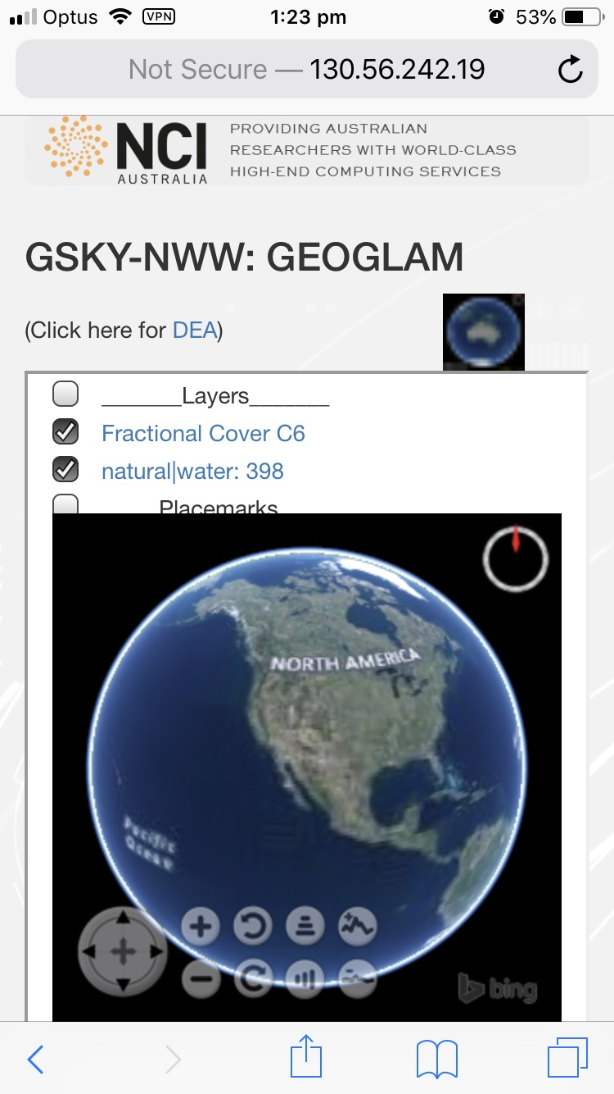
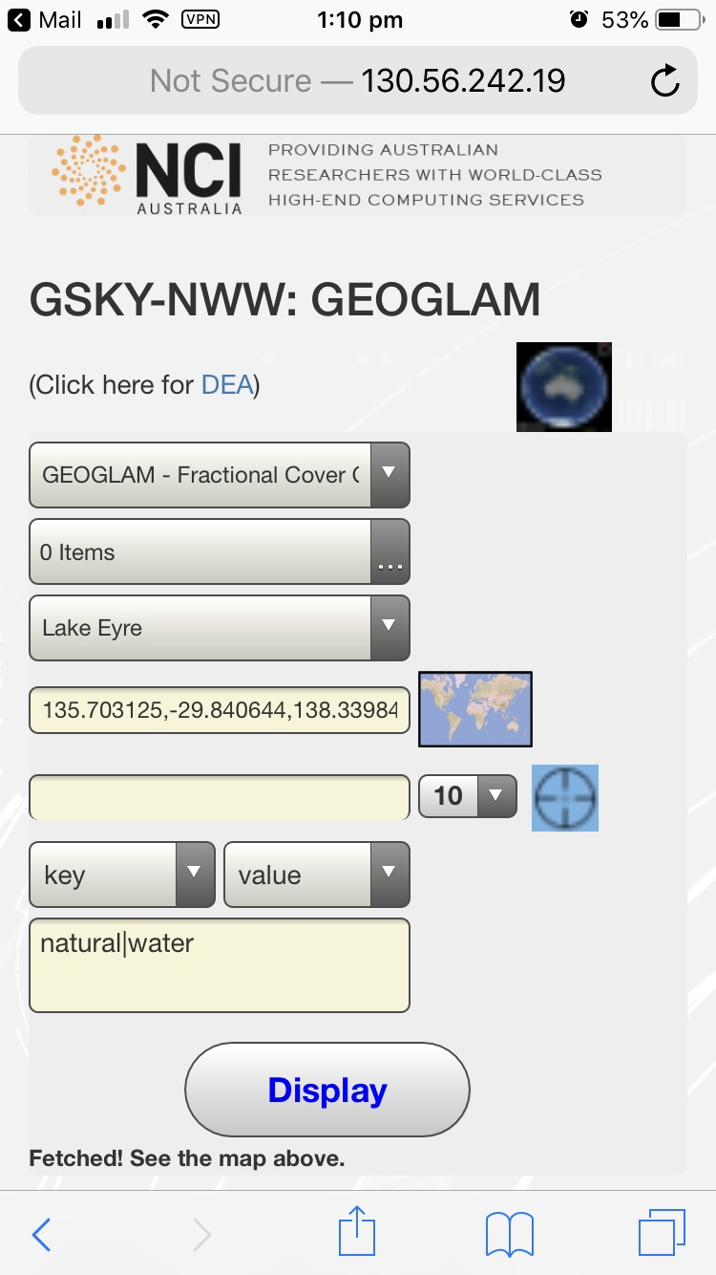
User Guide – Usage on Mobiles
This slide must be viewed as a slideshow
Choose the layer
A key/value for overlay (optional)
Click the Bbox finder
Position the crosshair
Select the number of tiles
Click the crosshair icon
Click the layer link
or the Overlay link
Uncheck the layer
Uncheck the Overlay
Close the World Wind pane

Slide 36
Tutorial
Objective
In this tutorial we will explore the use of NASA World Wind…
To display GEOGLAM data through GSKY
To overlay the data with terrain features
Requirements
Desktop (Mac or Windows) or Laptop with at least 8GB RAM
Mobile version is coming, but is not yet ready!
Chrome web browser
Does not work on Internet Explorer. Can someone try it on Safari and/or Firefox?
VPN or Ethernet connection to the NCI Network
This restriction will be removed by placing the system on production server later on

Slide 37
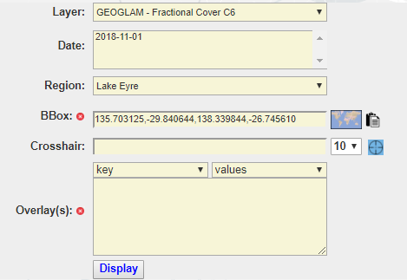
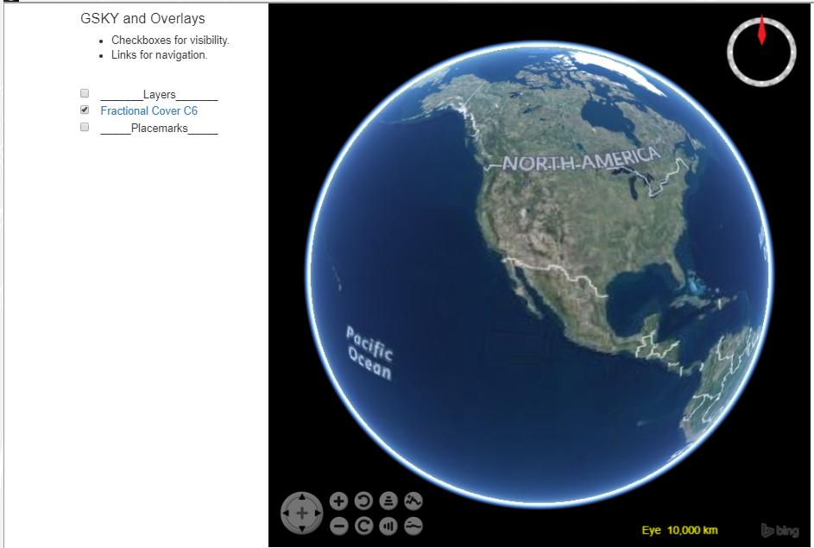
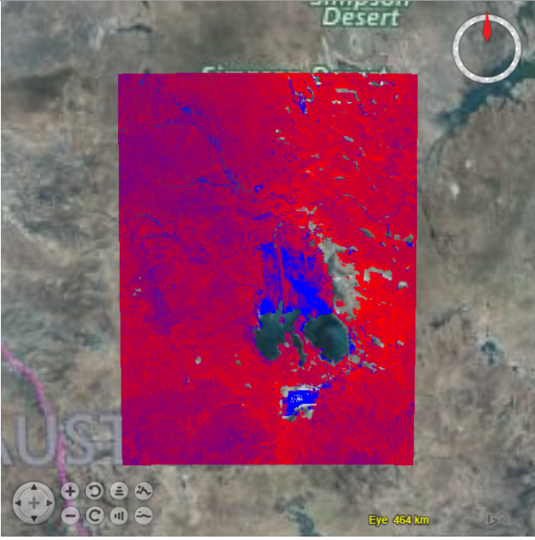
Tutorial
Start
Bring up the URL below on a Chrome browser.
http://130.56.242.19/NASA/WorldWind/geoglam_wrapper_kml.html
The page will show, among other things, the control form on right.
Firstly, run it as default…
Do not change any setting.
Click ‘Display’
A window with a 3D image of Earth appears.
Click on ‘Fractional Cover C6’
What you see is the GEOGLAM layer over Lake Eyre region.
Next: Place an overlay

Slide 38
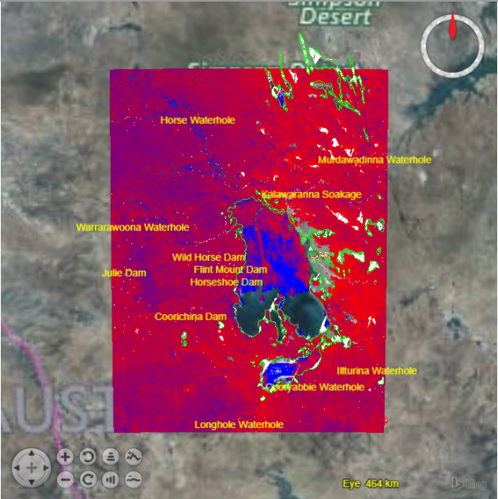
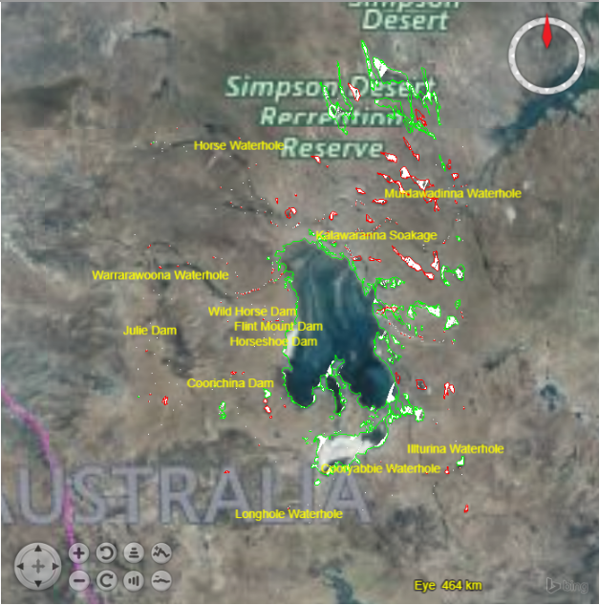
Tutorial
Natural Water Overlay
Click the ‘key’ dropdown
Select ‘natural’
Click ‘values’ and select ‘water’
Click ‘Display’ again
Click on ‘Fractional Cover C6’
See the GEOGLAM layer and water bodies over Lake Eyre region.
Uncheck ‘Fractional Cover C6’ by clicking its checkbox.
You will see just the water bodies over Lake Eyre region.
Next: Choose another region

Slide 39
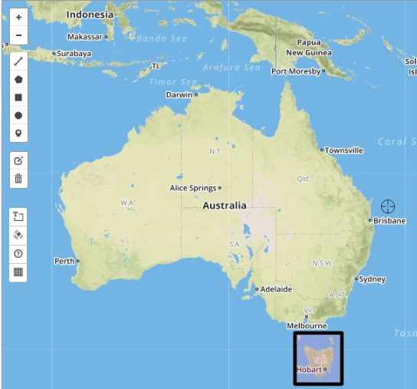
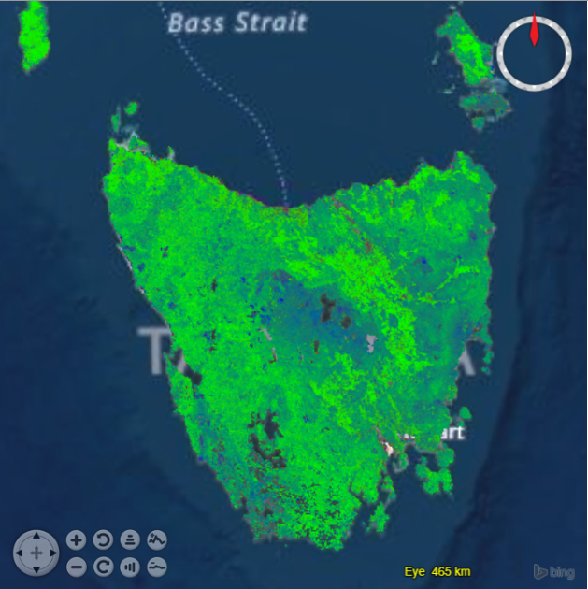
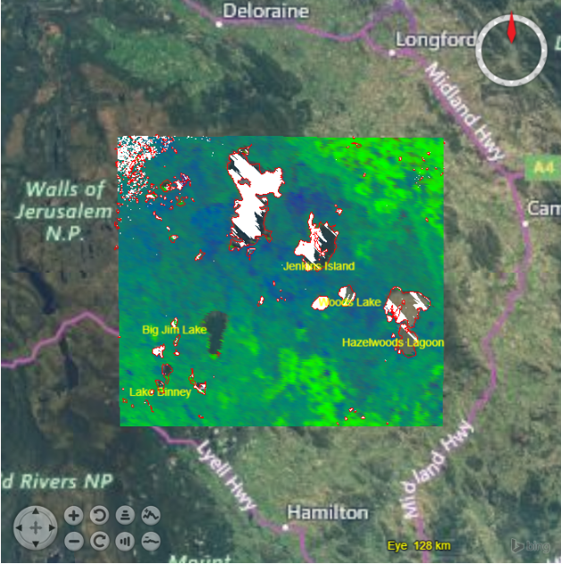
Tutorial
Look at Tasmania
Click the Bbox Finder
A world map opens up.
Pan to Australia
Click the Bbox tool and draw a box around Tasmania
Turn OFF the ‘Overlays’, as the selected area is too big.
Click the ‘Paste’ button.
Draw a smaller Bbox and add the water overlay again.
Next: Point the Crosshair

Slide 40
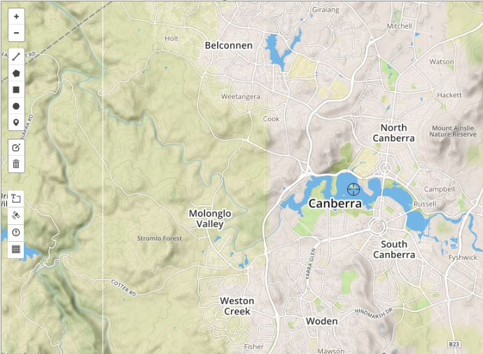
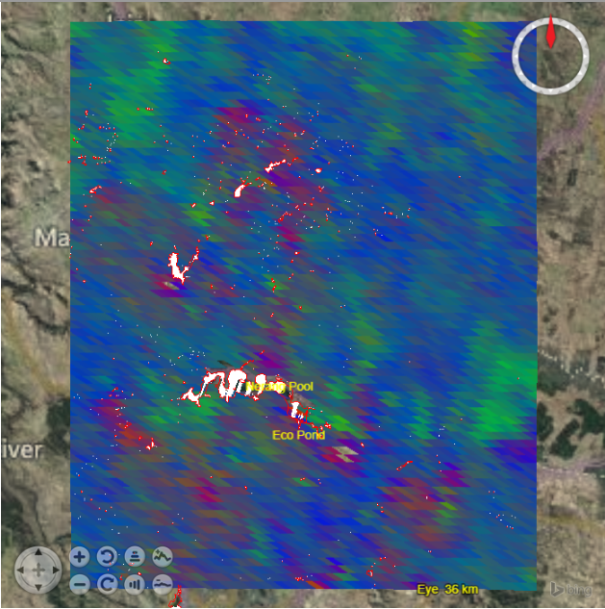
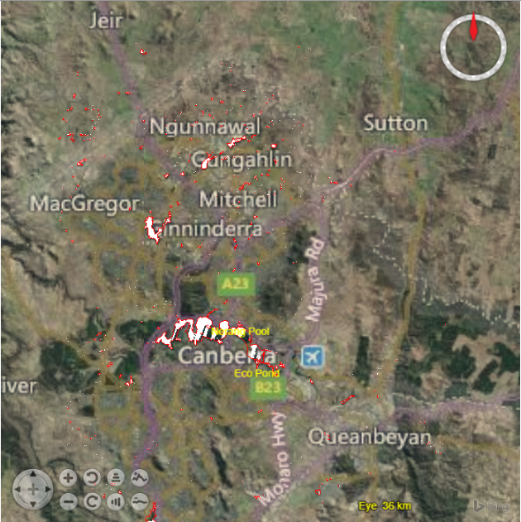
Tutorial
Zoom around Crosshair
Click the Bbox Finder
A world map opens up.
Pan to Canberra
Place the crosshair in Lake Burley Griffin
Choose ‘1’ from area dropdown.
Click the Crosshair icon.
Next: Multiple Dates

Slide 41
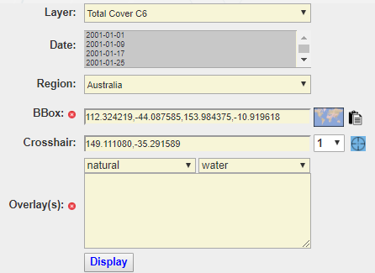
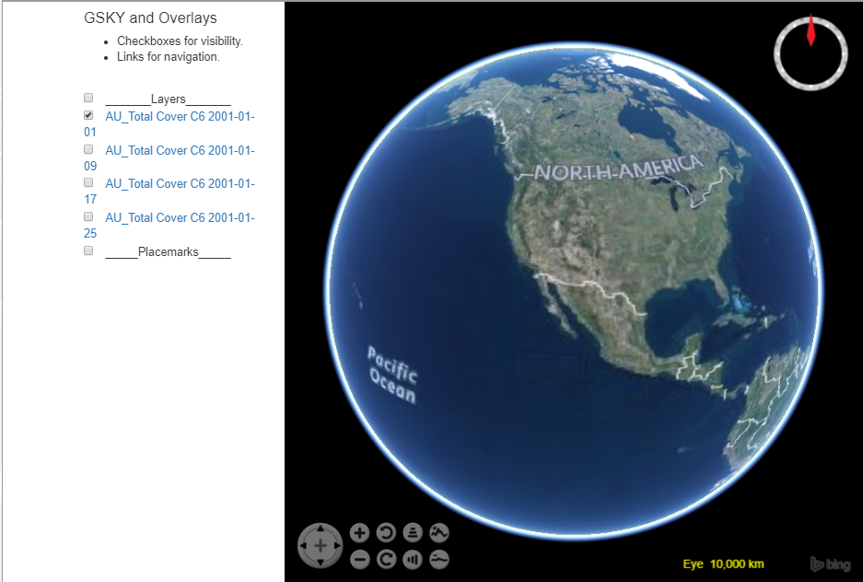
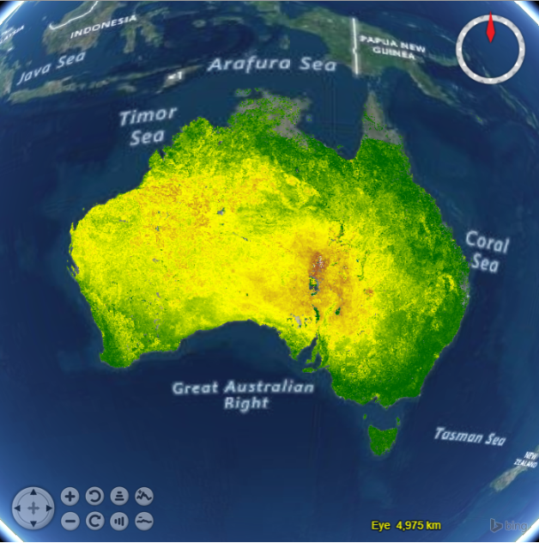
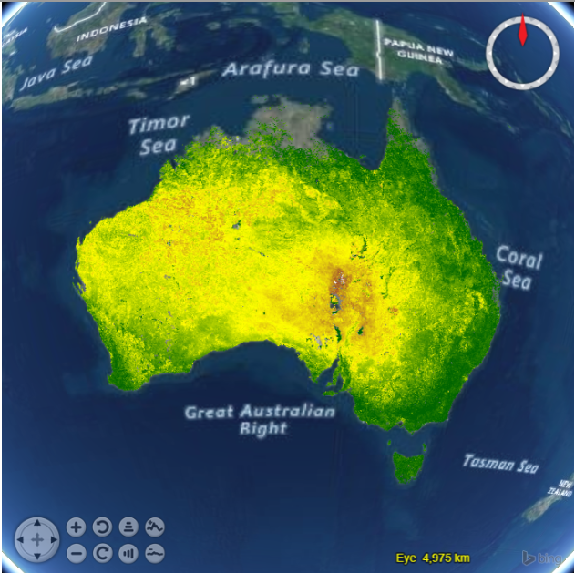
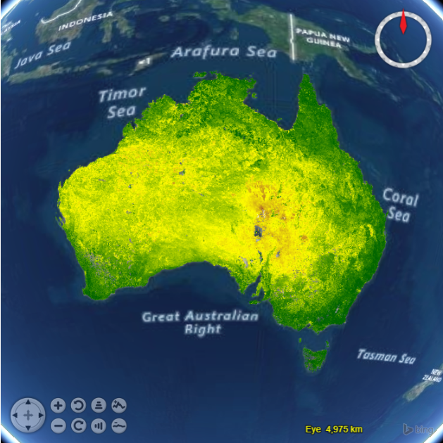
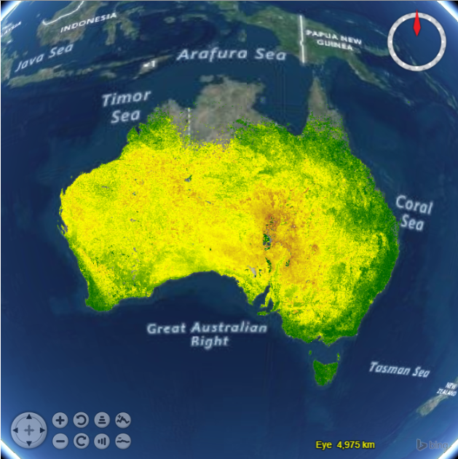
Tutorial
Multiple Dates
Choose ‘Total Cover C6’ for Layer.
Ctrl-click 4 dates, three months apart.
Choose ‘Australia’ for Region.
Click ‘Display’
Check/uncheck the layers to see the differences.
You can toggle layers to see progressive changes.
Super-impose two or more layers, but the topmost layer may mask others.

Slide 42






Acknowledgements

